Slide 1



Taking a Whole School/MAT Approach to Implementing self-regulation & metacognition
Marc Cooper (CELT)
Jon Eaton (KRS)

Slide 2
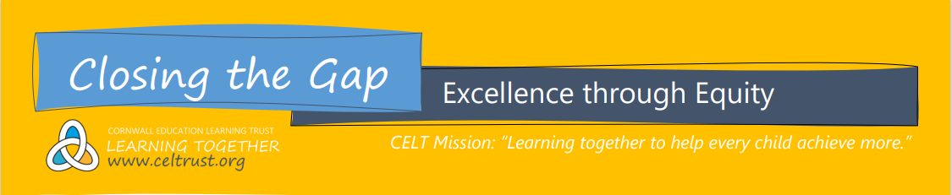
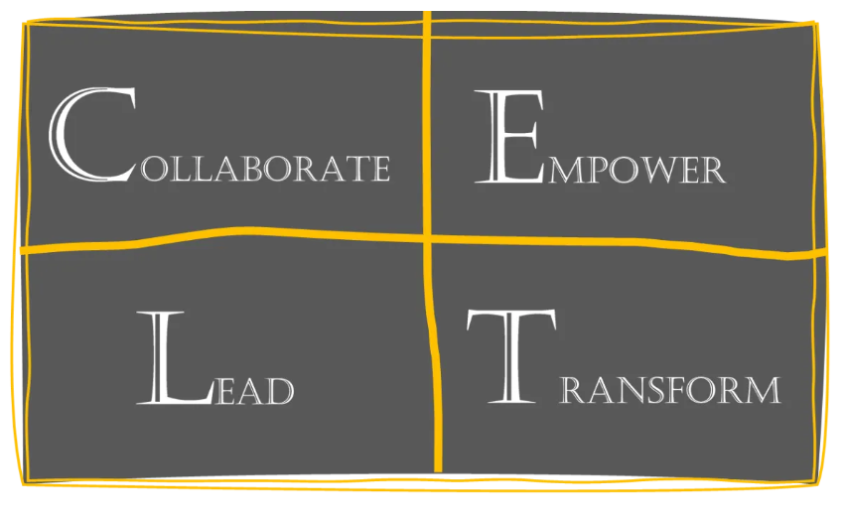
CLOSING THE GAP
BUILDING A TRUST-WIDE, CROSS-PHASE SCHOOL IMPROVEMENT STRATEGY
Marc Cooper, CELT (Chair)
Richard Cardigan, Penrice
Simon Disney-Pollard, Carclaze
Stewart Gynn, Mevagissey & Luxulyan
Julie King, Newquay Tretherras
Alana McGovern, Mount Charles
Natalie Simmonds, Lostwithiel
Richard Baker, Poltair
Laura Hocking, Brannel
Debbie Tregellas, Pondhu
Lisa Mann, NT Junior
Elaine Badger, St Mewan
Kate Sicolo, Fowey
Joe McGovern, CELT SENDCo
Richard Horswell, CELT Data
CTG STRATEGY AIMS:
Minimise the impact of the Coronavirus Pandemic on the progress and outcomes of disadvantaged learners, now and in the future…
Create a sustainable, evidence-based approach to developing powerful learning & teaching, that improves outcomes for all pupils…
To secure an enduring and productive professional learning culture, providing guidance and support for all teachers at all stages, across CELT…

Slide 3
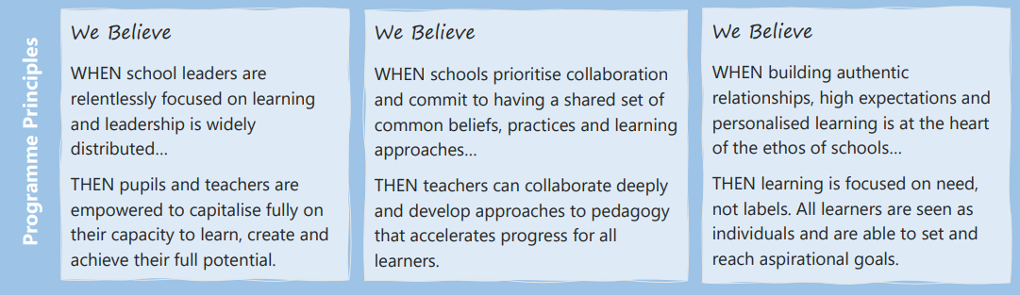
Closing the Gap is CELT’s School Improvement Strategy. Our goal is to create a sustainable, evidence-based approach to developing powerful learning & teaching, that improves outcomes for all pupils, in particular the disadvantaged. We aim to secure an enduring and productive professional learning culture, providing guidance and support for all teachers at all stages, so that every teacher across CELT can work together to develop outstanding classroom practice.

Slide 4

Closing the Gap is CELT’s School Improvement Strategy. Our goal is to create a sustainable, evidence-based approach to developing powerful learning & teaching, that improves outcomes for all pupils, in particular the disadvantaged. We aim to secure an enduring and productive professional learning culture, providing guidance and support for all teachers at all stages, so that every teacher across CELT can work together to develop outstanding classroom practice.

Slide 5



Reading Reviews across Primary & Secondary
Reviews of research & guidance: CELT ‘Remote Reading Guidance’
‘Reading for Pleasure’ Open University

Slide 6


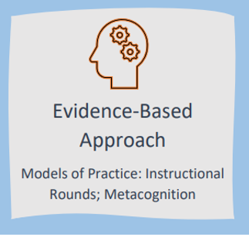
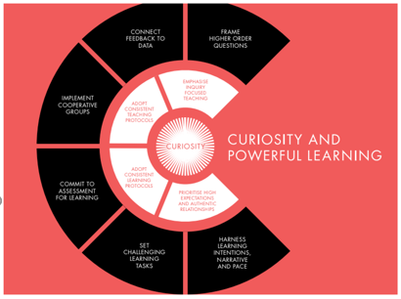


CELT Learning & Teaching Framework
Instructional Rounds
Metacognition & Self-regulation

Slide 7

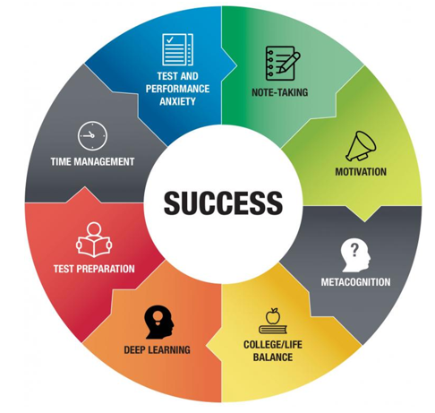
Coaching for Progress
Research: Case Studies
Pupil Voice

Slide 8
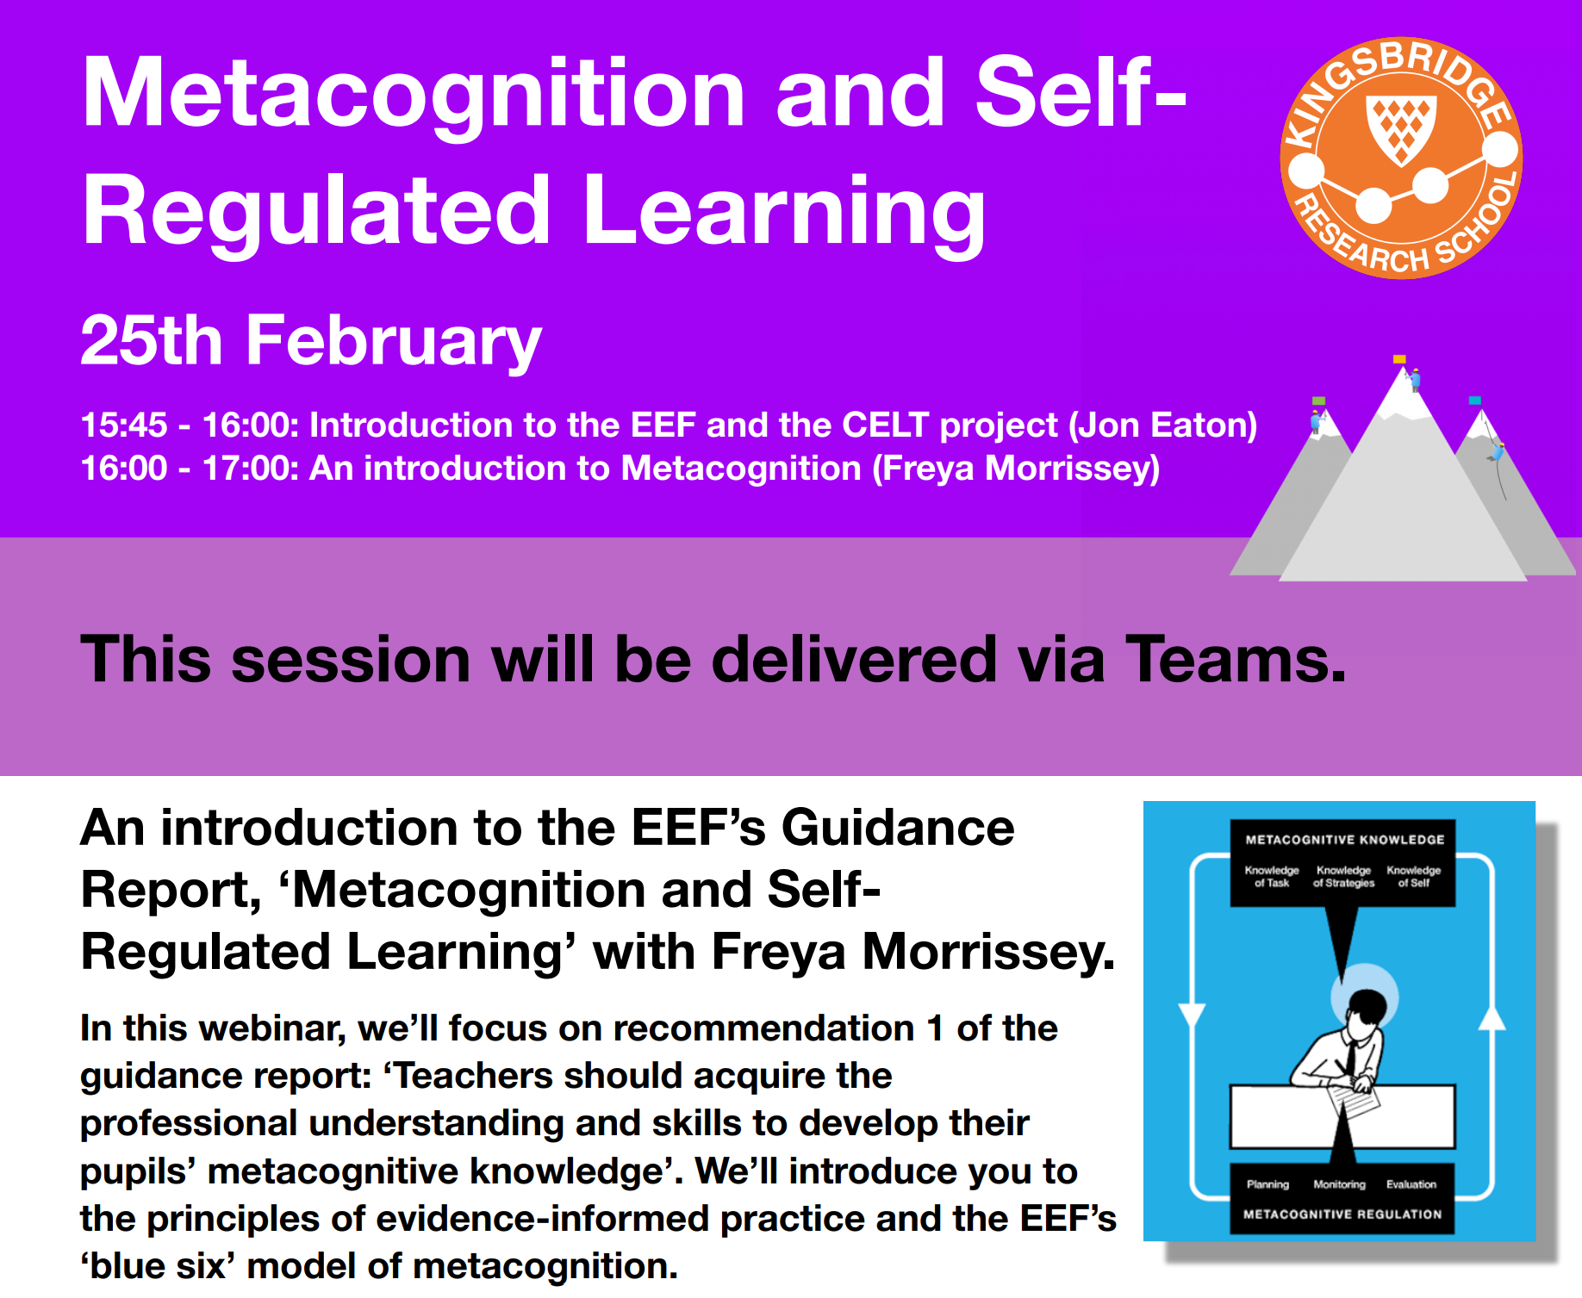
Metacognition & Self-regulation

Slide 9
How this aligns with the EEF
The Education Endowment Foundation (EEF) is dedicated to breaking the link between family income and educational achievement.

Slide 10
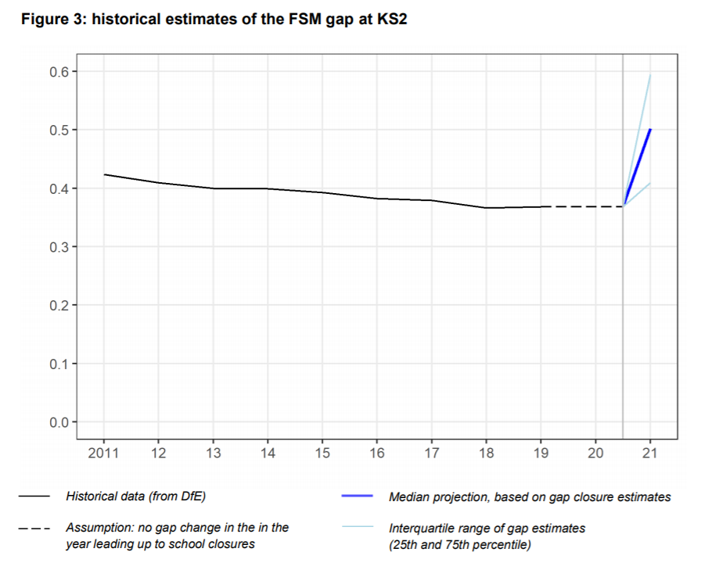
How this aligns with the EEF

Slide 11
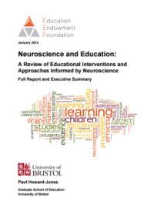
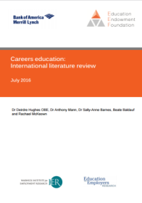
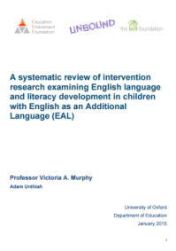
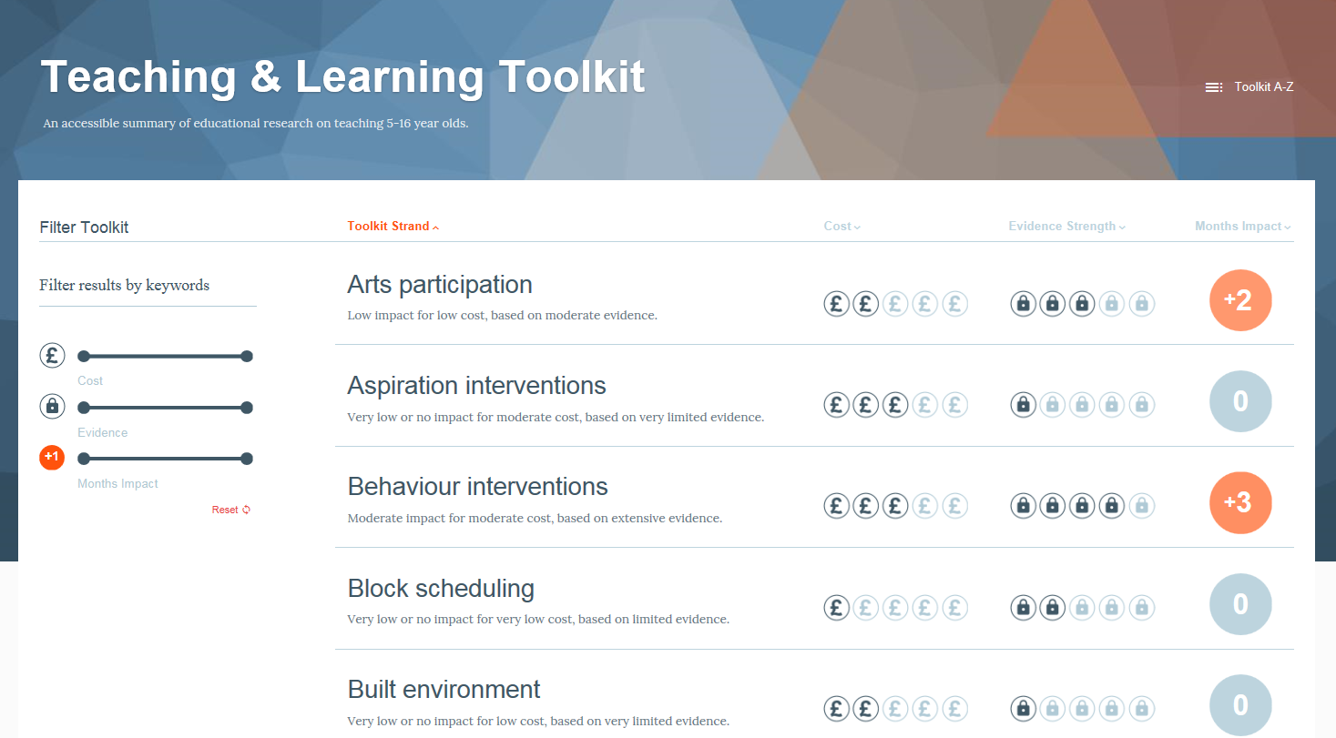
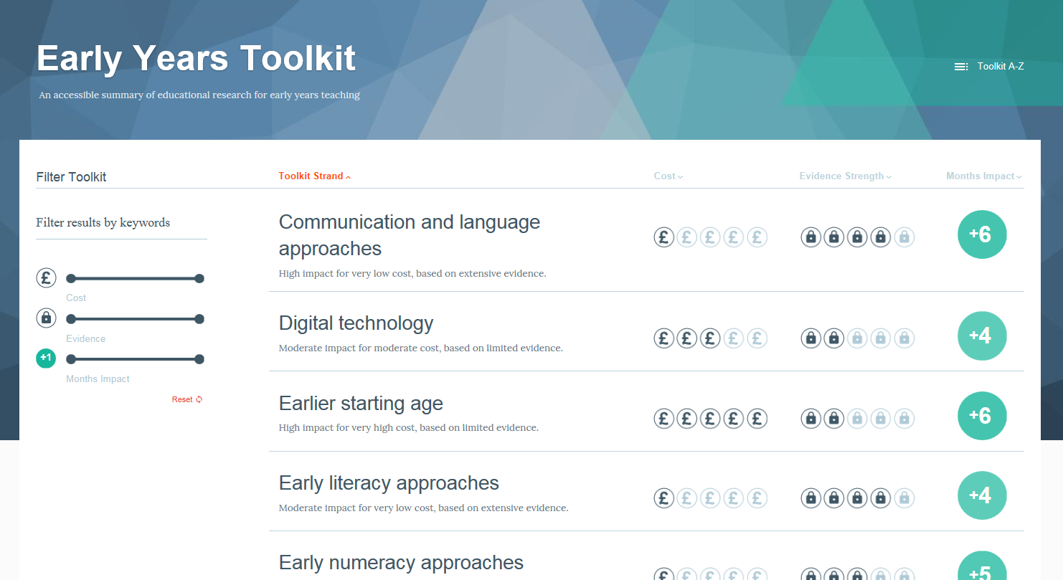

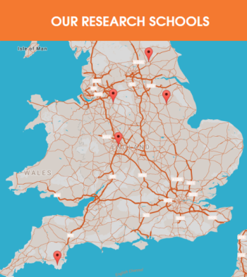
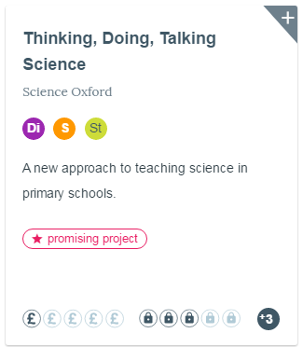


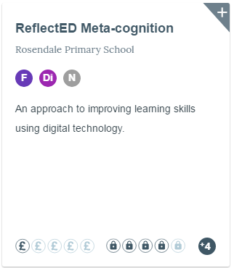
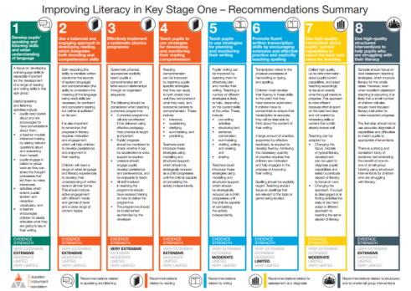
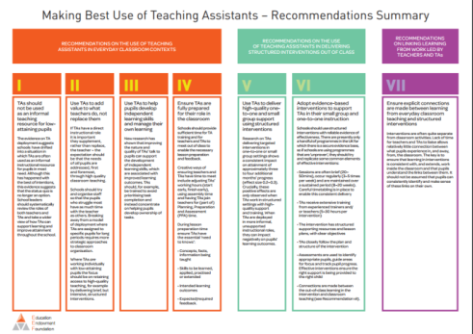
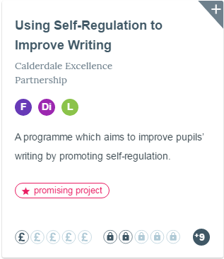
The EEF in brief
children and young people reached
Synthesis
1,300,000
13,000+
Generation
Mobilisation
schools, nurseries, colleges involved

Slide 12
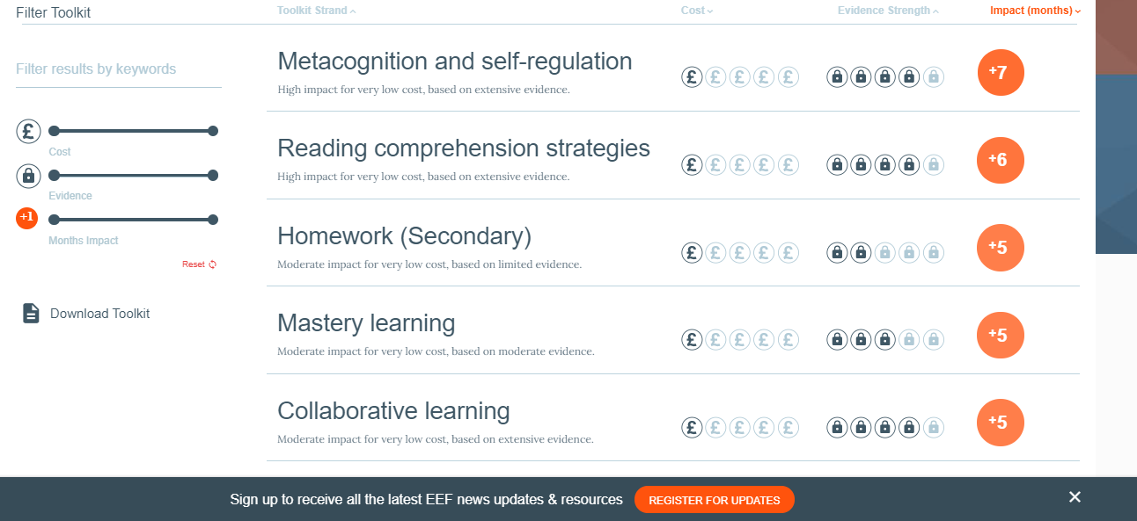
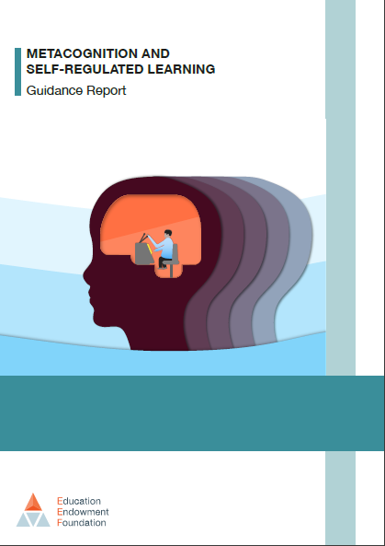
Why did we focus on metacognition?

Slide 13
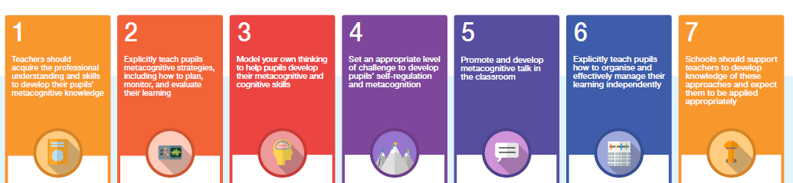
The Metacognition guidance in brief…

Slide 14
There’s a robust evidence base
Draws on an evidence review of over 1000 research papers: it’s a synthesis of our understanding and some ‘best bets’
An accessible but detailed starting point to build shared theoretical understanding
Aims to bridge the gap between theoretical evidence and classroom practice
Not intended as a ‘definitive’ document

Slide 15
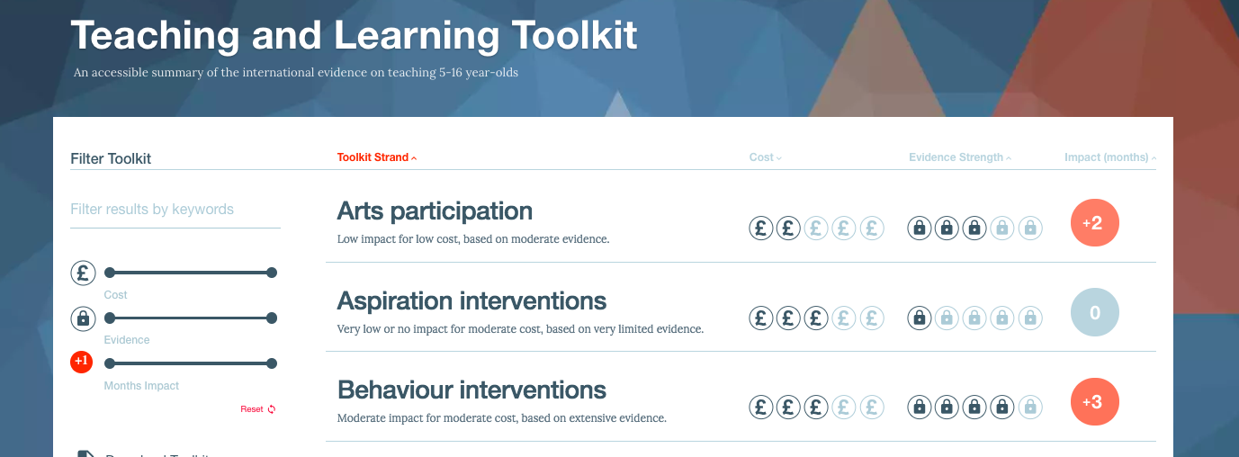
It focuses on the classroom
The most impactful strategies are likely to be those that involve a close interaction between teaching professionals and pupils in the classroom.
Low-cost, high-impact strategies of feedback and metacognition, are likely to have most impact.
The least impactful strategies in the Toolkit are looser, less-focused interventions such as aspiration interventions, after school programmes or reducing class size.

Slide 16
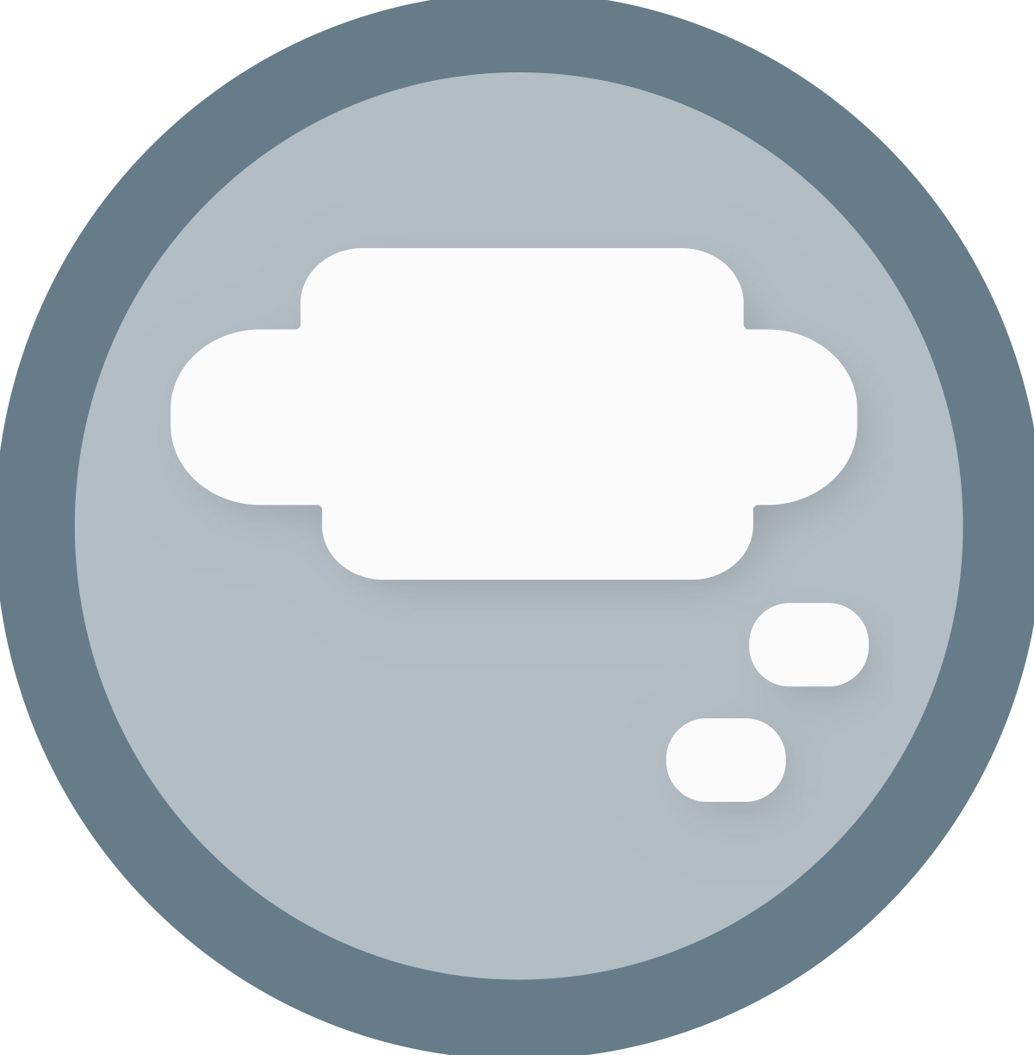
It directly addresses disadvantage
The most effective learners self-regulate and organise their approach to learning
Metacognition is a high-impact approach to improving the attainment of our least effective learners
It can be taught
It is especially powerful when subject-specific

Slide 17
But it’s not JUST the metacognition practice…
Metacognition Practice
Engagement with high-quality evidence
Teachers have improved knowledge of metacognition
This translates into improved classroom practice
Students’ metacognitive knowledge and behaviours improve
Improved outcomes
Without implementation training and support
Drifts from the evidence base, the programme fades

Slide 18
It’s implementation as well…
Revisits the evidence, keeps it ‘present’
Metacognition practice
High quality engagement with the evidence
Effective implementation
Sustained implementation support
Improved outcomes
Implementation process
Helps school engage with and understand the evidence, matches it to a strong understanding of context
Without the implementation training and support
Drifts from the evidence base, the programme fades

Slide 19



Slide 20
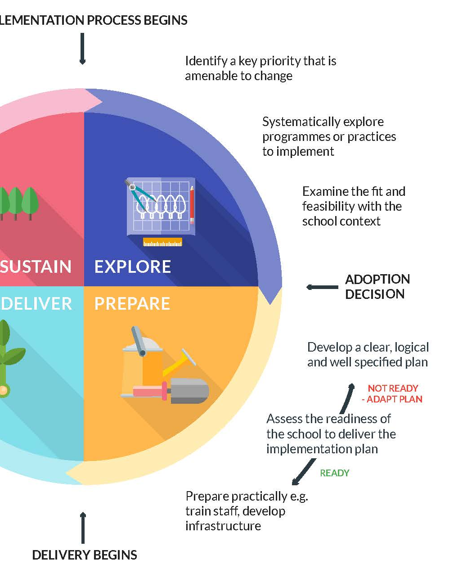
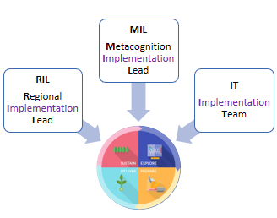

Slide 21
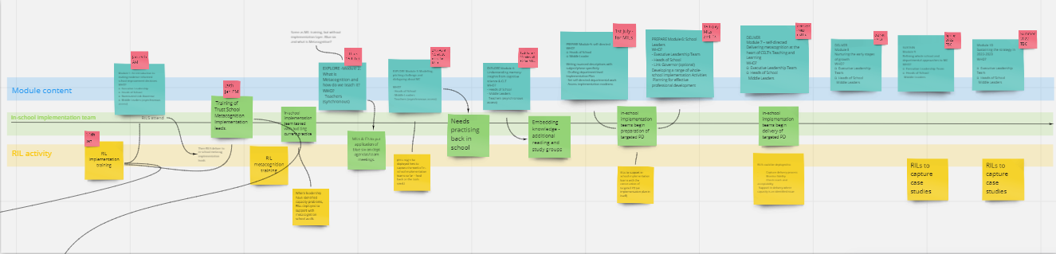

Slide 22
In the vignette on the next slide, where do we see:
Good metacognition practice (i.e. understanding of and fidelity to the principles of metacognition)?
Poor metacognition practice?
Good implementation processes?
Poor implementation processes?
Notes:
Give time for them to individually write down their comments (5 mins) – since it does not appear to turn out well for Frank, they might read ‘good’ as ‘things that at least have the potential to be good’!
, then discuss

Slide 23
As a newly appointed T&L Lead, Frank is eager to show rapid impact. He sees on Twitter that metacognition, according to a snapshot of the EEF’s Teaching and Learning Toolkit, leads to 7 months’ additional progress. Since he has been charged to lead a whole-staff meeting a fortnight later, he decides that the focus will be on metacognition.
His initial reading gives him the impression that metacognition involves teaching thinking skills, but Frank soon realises that it’s a more complex topic than he thought. He realises he needs to explore the practice in much more depth and settles down to some intensive reading. At the same time, he feels under pressure to put something together for the staff meeting. He decides to focus on one element and do that well: teacher modelling will be the focus. Frank spends a great deal of time putting together some high-quality resources based on the EEF’s modelling framework.
At the staff meeting, Frank presents the modelling framework in a step-by-step way and gives an example of how it might be used in practice. There is an opportunity for staff to ask questions. On the whole, they seem enthusiastic and keen to try it out.
Over the next couple of weeks, Frank pops into several lessons until he finds examples of teacher modelling. The head of English tells him that her department have really found it useful – in fact, many of them have made it their own, adapting it to suit their lessons.
By this point, there is another staff meeting on the horizon. Frank searches for something new …
Notes:
Either give time to read it or read it out

Slide 24

Work out a theory of change, look for weak links and aim to support them
Use high-quality sources of evidence
Presentation is not engagement
Find multiple ways to create engagement – ‘none must escape’
Aim to build implementation expertise as much as – if not more than – expertise in the practice itself

