Slide 1
Adapting Mainstream Provision to meet a changing profile of needs
15th June 2021
Paul Hodgkinson
Executive Principal

Slide 2
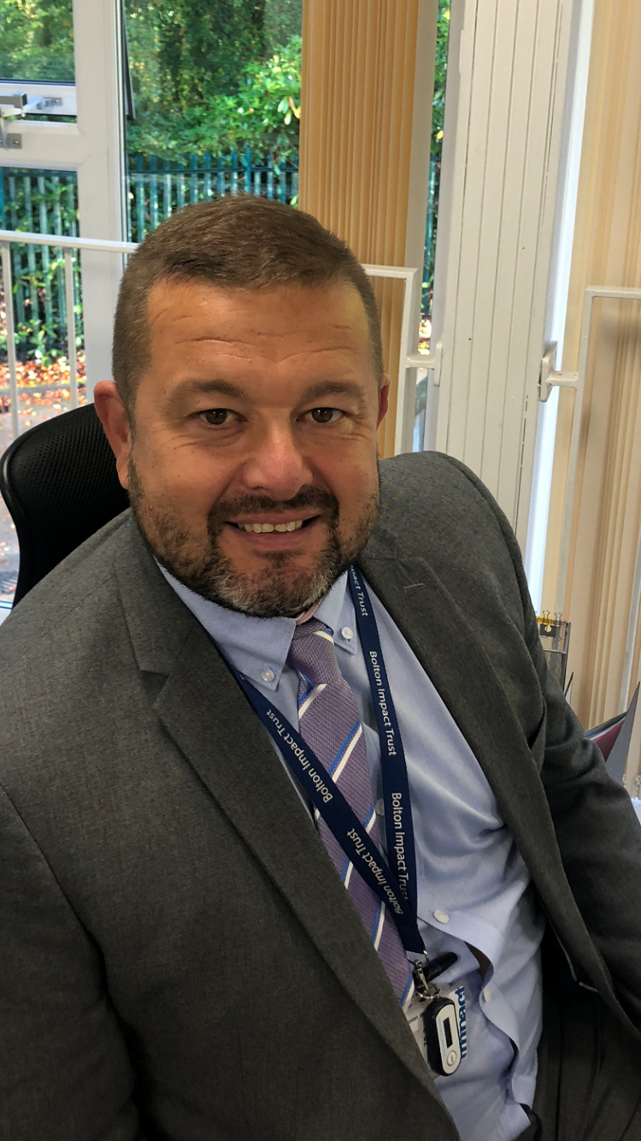
About me
Taught PE and Maths in a PRU (from 1997)
First Headship in a PRU in 2005
Head of Federation of 4 PRUs from 2010-2016
Executive Principal of Bolton Impact Trust since 2016
Executive Board member of the National AP/PRU Organisation PRUSAP
Involved in 50+ School to School Support assignments since 2011
Our Schools/Academies have been judged Outstanding by Oftsed on 8 separate occasions

Slide 3
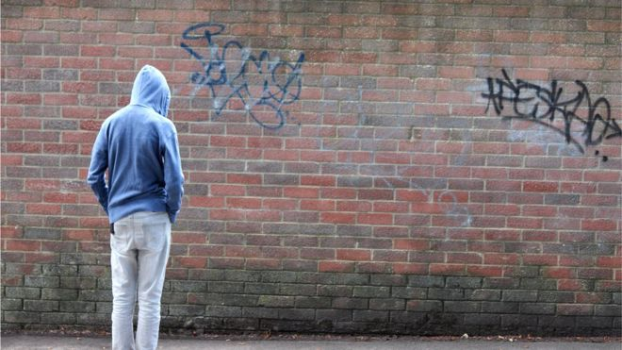
What Alternative Provision isn’t!
“Dumping ground”
“Last step before Prison”
“The cause of Knife Crime”
“Born to fail..”

Slide 4

What Alternative Provision is?
The best of Alternative Provision is a joy to behold. They take children and young people battered by life, rejected and in some cases further damaged by their mainstream experiences, slowly piecing them back together; supporting them as they move on in life.
Leading Learner, 2019

Slide 5
Aims of the session
Briefly explain who we are
Look at some ‘readiness for learning’ strategies which we employ across the Academies in our Trust
Introduce the concepts of the ‘window of tolerance’ and Learning zones
Look at some of our key guiding principles
Case study analysis

Slide 6
About us - Bolton Impact Trust
5 AP/Special Academies
Previously Bolton Pupil Referral Service (LA provision)
Converted to Multi-Academy Trust in April 2016 in order to Sponsor Lever Park Special School
Work closely with the Local Authority and Bolton’s Schools in supporting some of the town’s most vulnerable learners
Provision for 256 Bolton learners (187 AP + 69 SEMH Special)
Work directly with other Local Authorities

Slide 7
Our (AP) Pupils
Aged from 5 – 16
Permanently excluded from mainstream schools
At risk of permanent exclusion from school
EHCP for Social Emotional & Mental Health (SEMH)
Pregnant
Mental Health issues
Physical illnesses
Terminal illnesses
Phobic
Some come form very turbulent home lives

Slide 8
Since March 2021
Significant surge in referrals to our Academies
Rise in Year 7 exclusions
Rise in Primary exclusions
Less incidents of Persistent Disruptive Behaviour (more one-offs)
First set of exclusions for knife-related incidents
More children in the hospital ward
Significant increase in requests from schools for our intervention packages

Slide 9
Key strategies
3 stage curriculum design model
Phase 1 and Phase 2 Outcomes
Ipsative Key Performance Indicators (Personal Success Targets)

Slide 11
Phase 1 outcomes used in Bolton Impact Trust Academies (The hidden curriculum)
Background
In October 2017, the Making the Difference report into standards in Alternative Provision was published. Included in the report was reference to a lack of understanding around what success actually looks like in AP settings
….there has been very little research into what works in engaging and improving the trajectories for excluded pupils. In fact, there is no consensus over what ‘success’ looks like in AP. The most recent government-commissioned review of alternative provision called for ‘further research on evaluating attainment and progression … to identify tools that can be used to ascertain the effectiveness of AP and related interventions’ (Tate and Greatbatch 2017). Put simply: we don’t even know how to measure success in AP Settings…
Our Response
In response to this and in acknowledging that a large part of our work is carried out in order to eliminate inhibitors to learning, the Trust leadership team began to analyse the impact of the work that we do to reduce the impact of the restrictive factors that our pupils encounter. We now break our outcomes down into phase 1 and phase 2 outcomes.
Phase 1 outcomes relate to a critical part of our work and measure pastoral indicators. Evidence is collected and analysed each term in relation to engagement, attendance, resiliency, social ability, behaviour, mental well-being and quality of life.
Phase 2 outcomes are related to academic and vocational progress, attainment and positive destinations.

Slide 12
Phase 1 Outcomes | Phase 2 Outcomes
Engagement and attendance (including at home and in the community) Behaviour Pupil commitment to learning in the sessions attended Social/community contribution Pupil satisfaction / Happiness Building resiliency (and anxiety reduction) Experiencing success and failure Building and maintaining positive relationships Trying new things | In year progress in subjects studied Progress from baseline Flight path improvements Accreditation Work experience and voluntary placements Post 16-destinations Return to school statistics

Slide 13

Ipsative measures (Rewarding Personal Bests)

Slide 14
Window of Tolerance
The ‘Window of Tolerance’ (Siegal, 1999; Ogden, et al.,2006) is the optimal zone of arousal where we are able to manage and thrive in every day life. This can be thought of as sailing within a river of well-being (Siegel & Bryson, 2012) where we are able to respond to all that comes our way without getting thrown off course.

Slide 15
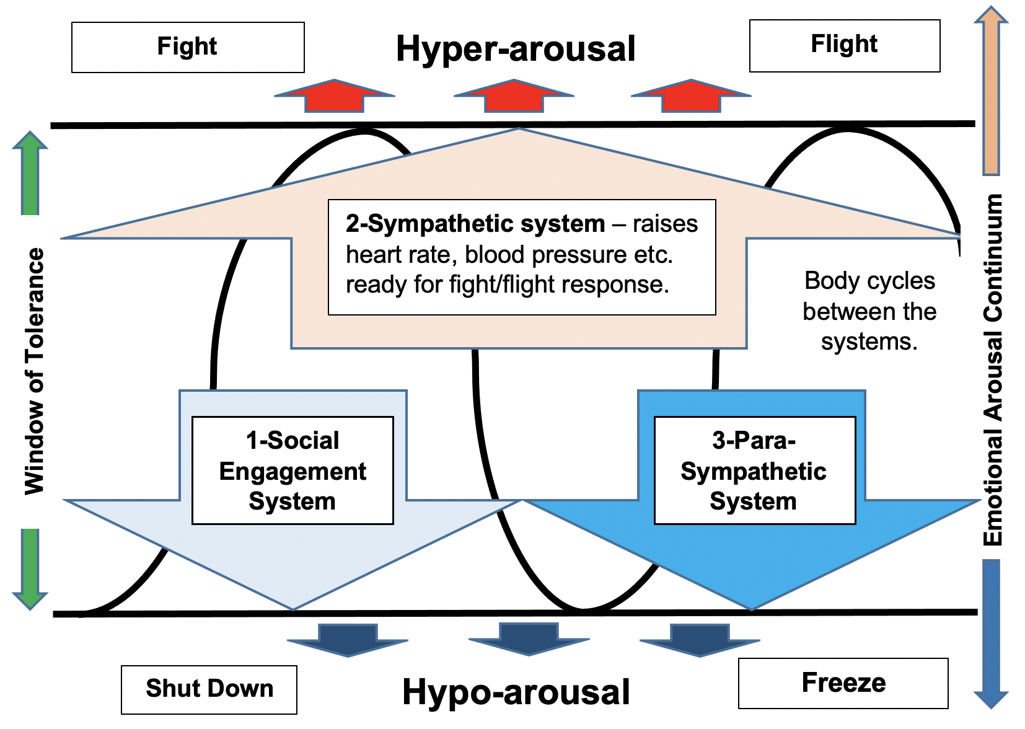

Slide 16
1. Understanding emotions (Cameron)
Our first guiding principle is that we help anxious and distressed children be less anxious and distressed …by doing everything we can to help them operate within their window of tolerance and never putting them in a situation which pushes them into hyper-arousal

Slide 17
2. Resilience
Our second guiding principle is that we aim to send children home each day with a new set of genuine, positive, happy memories...to help each individual’s window of tolerance grow gradually wider.

Slide 18
3. Relationships
Our third guiding principle is that we help children build relationships and make friends…so that they can use social engagement to self-regulate and prevent tipping into hyper-arousal

Slide 19
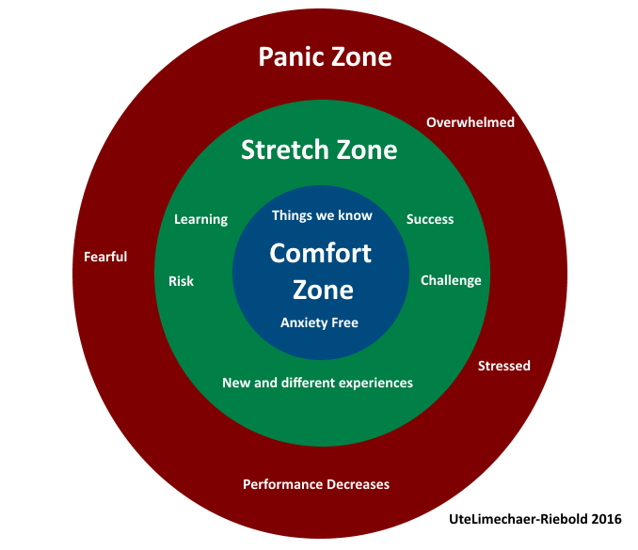

Slide 20
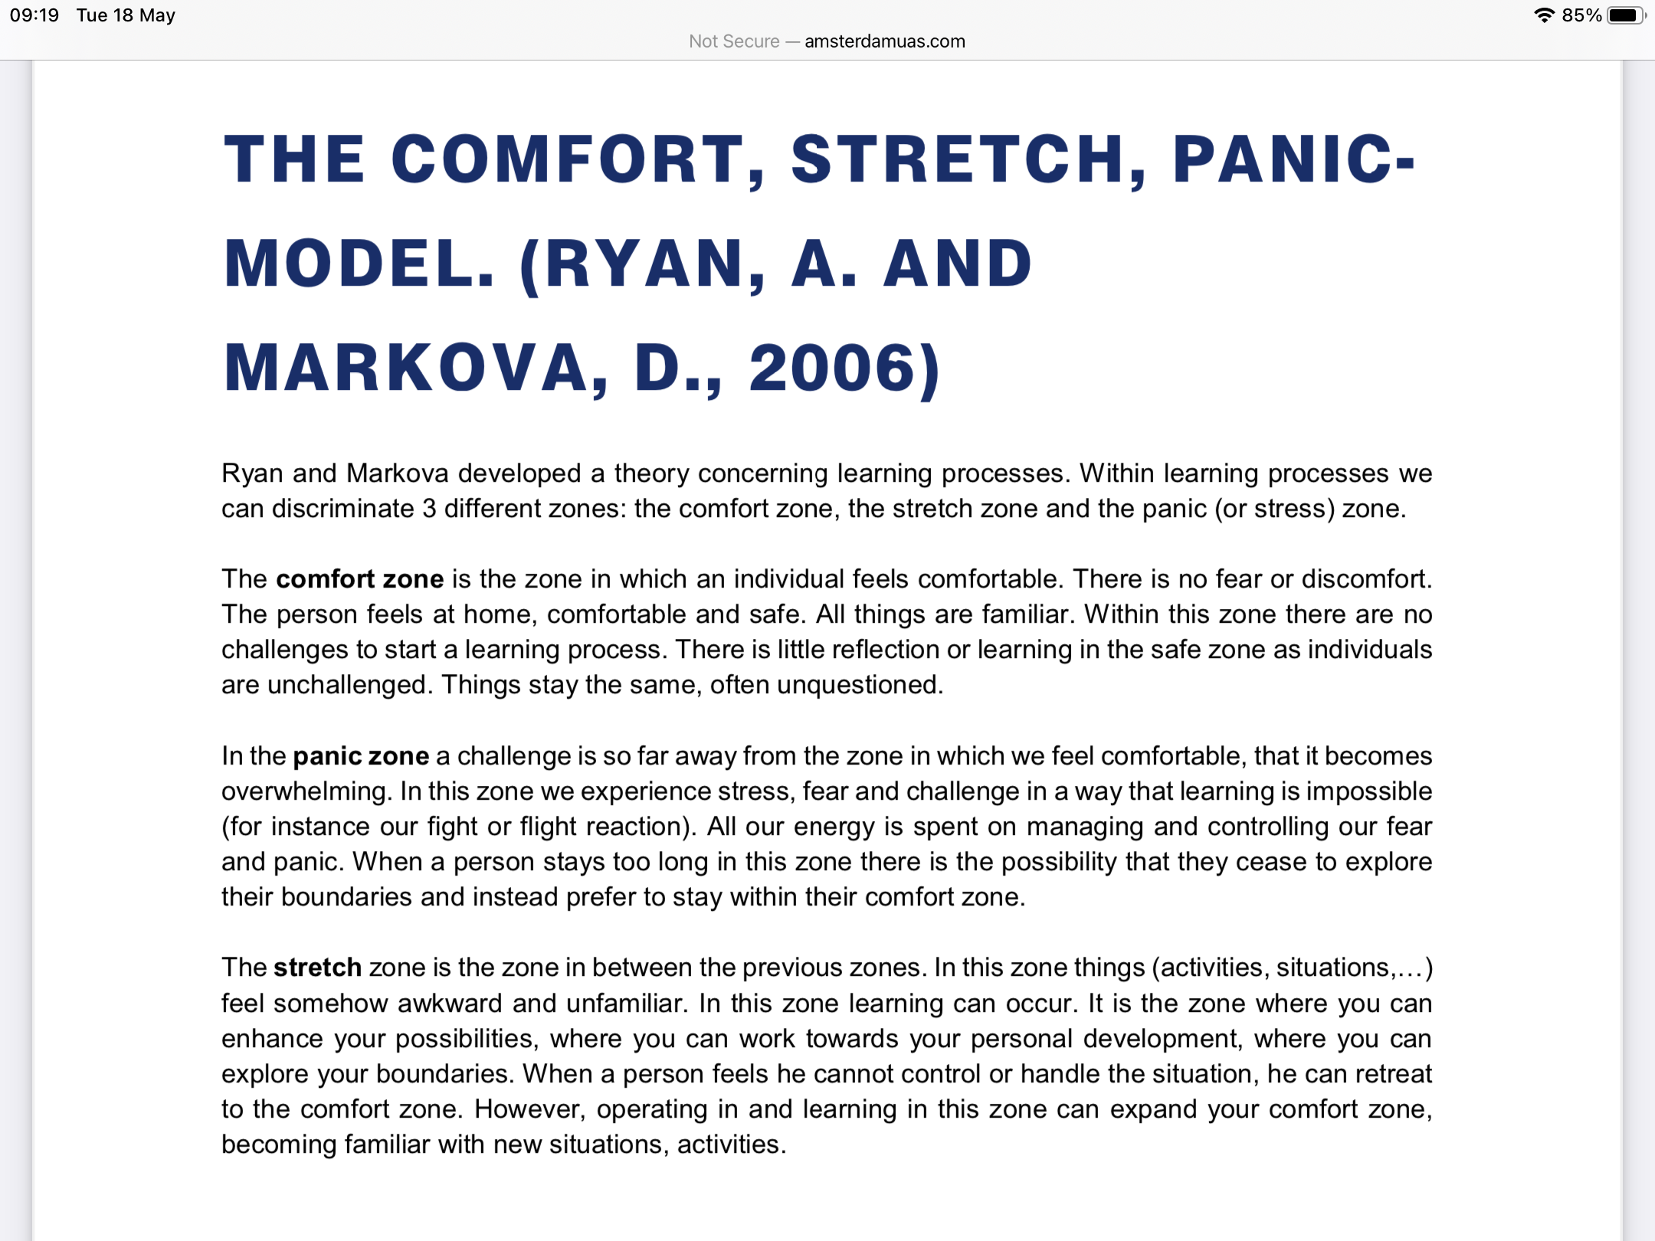

Slide 21
Other strategies (non-text book!)
‘Planned sabotage’
‘On your toes’
Sharing strategies with schools (Sean’s story)

Slide 22
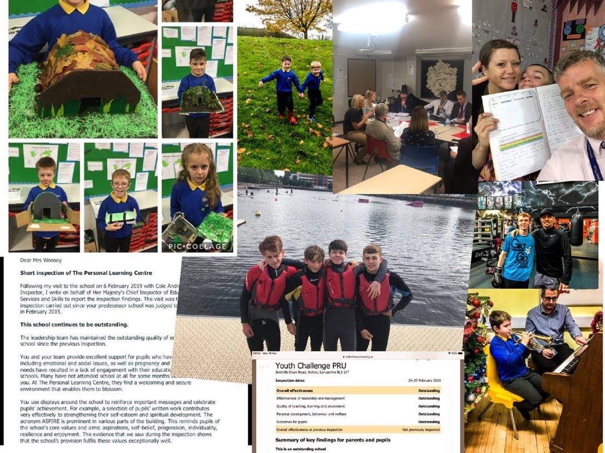
In Summary
Strong Curriculum design (and review) systems
Give time to intelligence-led pastoral interventions (Pastoral Objective tracking)
Celebrate individual successes (PBs)
Keep students within their own windows of tolerance
Apply child-centred guidance principles (supportive culture)
Don’t be afraid to ‘move through the gears’ but avoid taking students into their learning panic zones
Share what works

Slide 23
For further information
hodgkinsonp@boltonimpacttrust.org.uk
Twitter: @bolton_pru
Tel: 07985196435

