Slide 1

Senior Mental Health Leads Training
2-Day intensive online course

Slide 2


Trainer Introductions and
General Housekeeping

Slide 3

Group Agreement
As we all have our own life experiences, mental health statuses, relationships with others and more, it is important we can create a safe space.
What needs to be on our group agreement to make this happen?
Notes:
Listen to each other​
Show respect​
Celebrate diversity in all of its forms​
Don’t refer to young people by their names​
Examples shared stay within our group but learning should be shared as widely as possible​

Slide 4

Trigger Warning
We will be talking openly about mental health.
Do take time out and let us know if we can support you in anyway.​

Slide 5

Department for Education Learning Outcomes and Policy Background
2017 Green Paper, ‘Transforming children and young people’s mental health provision’
Subsequent consultation response from the Department for Education and Department of Health and Social Care (DfE & DHSC, 2018).
Our programme sits around the 8 Learning Outcomes set by the DfE (See next slide)
Notes:
Coach prompt:
One of the many reasons why this programme has been set up and why you are here today is because of the 2017 Green Paper ‘Transforming children and young people’s mental health provision.’
Core Green Paper proposals are:
To incentivise and support all schools and colleges to identify and train a Senior Mental Health Lead in every school and college by 2025.
To fund new Mental Health Support Teams (MHST) - trained staff linked to groups of schools and colleges
To pilot a four week waiting time for access to specialist NHS children and young people mental health services
MHSTs (Mental health Support Teams) will work across education settings and children and young people's mental health services (CYPMHS) to provide early intervention support for children and young people with mild to moderate mental health needs in schools and FE colleges.

Slide 6
What does the role of an SMHL mean to you?
What experience do you have supporting the whole organisation approach to Mental Health?

Slide 7
What is the role of a Senior Mental Health Lead?
As an SMHL, you will be responsible for raising awareness and increasing capacity to ensure that mental health and wellbeing are key priorities.
You will develop whole school mental health strategy which is a key aspect of organisational change initiative.
SMHLs will take a coordinated and evidence-informed approach to mental health and to improve student mental wellbeing through early intervention.
Develop cross curricular approaches that support pupils through the promotion and protection of wellbeing.
Work collaboratively with a team of key staff members who can support the implementation of whole school mental health and wellbeing.
Promote mental health and wellbeing through visible policies and embedded processes.
Notes:
Further responsibilities:
Review the school’s PSHE and RSE curriculum to ensure it includes the awareness of developing positive mental health and emotional resilience
Gather input from key stakeholders on what advice they would value and what their specific concerns may be
Maintain a publicly visible policy that sets out how the school supports pupils’ mental health and wellbeing
Develop and implement embedded processes that increase positive mental health and wellbeing
Assess staff mental health needs confidentially through staff surveys, feedback and by maintaining clear channels of communication
Create and implement a policy that sets out how the school promotes wellbeing for its staff, and address the areas of school culture that impact on staff wellbeing

Slide 8
DfE’s Learning Outcomes for SMHLs
Leadership and management
Identifying need and monitoring impact of interventions
Targeted support and appropriate referrals
Staff development
Creating an ethos and environment
Enabling the Student Voice
Working with parents, families and carers
Curriculum, teaching and learning.
Notes:
This is the list of the 8 learning outcomes which we have taken directly from the advice for training providers. These have also been included on our webpage and will help to shape our discussions later. Your learning is carefully mapped towards these and this is why we have set the small intervention project, audit, action plan and provision map to support you with meeting these by the end of the course. However, you will become part of our mental health network and will have access to ongoing webinars as well as other forms of support at the end of the course.

Slide 9
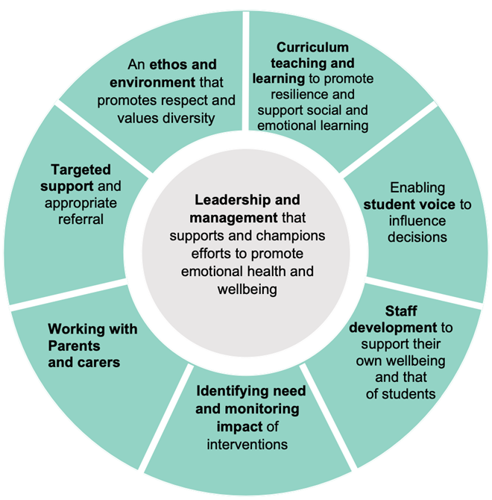
Whole School/College approach to Mental Health
Notes:
Senior Mental Health Leads are instrumental in driving forward a whole organization approach to mental health. Created by Public Health England in 2015 and updated in 2021, The 8 principles to promoting a whole school and college approach to mental health and wellbeing is presented in a wheel diagram with ‘leadership and management that support and champions efforts to promote emotional health and wellbeing’ at the centre.
Schools and colleges are in a unique position to help prevent mental health problems by promoting wellbeing, positive mental health and resilience as part of an integrated approach that is tailored to the needs of their pupils and students.
A whole school or college approach is one that goes beyond the teaching in the classroom to pervade wider aspects of school life. Training for senior mental health leads will explore the components of this in more detail.
The Department for Education published a report in May 2018 providing case study examples of the work schools and colleges have undertaken in nine key areas to support mental health including the whole school/college approach, identifying mental health needs and the role of the mental health lead. The case studies can be found here and illustrate the type of actions a setting may take as part of a whole school/college approach to mental health.

Slide 10

Benefits of a Whole Organisation Approach
Prevention and health promotion
Understanding how school systems support mental health
Supports effective teaching and learning
All pupils benefit from consistency
Promotes resilience
Notes:
NICE guidleines recommend adopting a whole school approach to support posieve social, emotional and metnal wellbeing
Prevention and early intervention key for CYP
REcognising that MH isnt something that happens to our YP outside of school. They bring it with them to school so a nurturing approach to education is vital
Children do better academically when their emotional needs are also being met
No one falls through the cracks
Resilience such an imporatn skill for our YP but its like a muscle, needs to be build up to be strong

Slide 11

Benefits of a Whole Organisation Approach
What might the barriers and challenges be to implementing this?

Slide 12


This is the beginning of your professional and organisational journey
Notes:
Rome wasn’t built in a day – small steps, small changes, small wins add up to wider organisational change

Slide 13
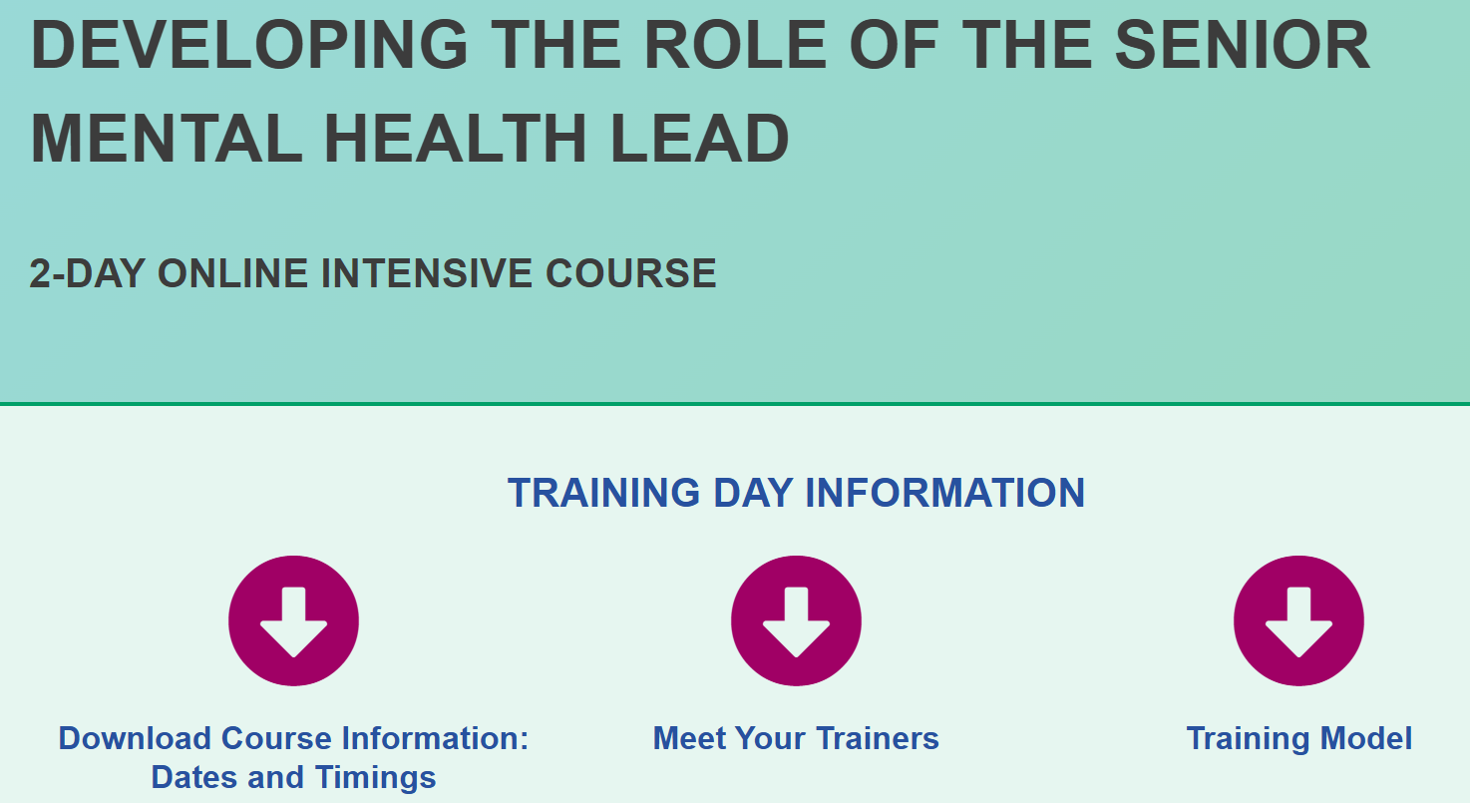
Resources Tour
SMHL 2-Day Intensive Online Course - Creative Education
Notes:
Use these to upskill your teams

Slide 14
Support and Develop your Staff
Effective mental health provision requires a whole-school or college approach. To support you to support your colleagues we have developed a Staff Development Toolkit. Download the whole toolkit or review what’s available on the resources page.

Slide 15

The Eisenhower Matrix

Slide 16
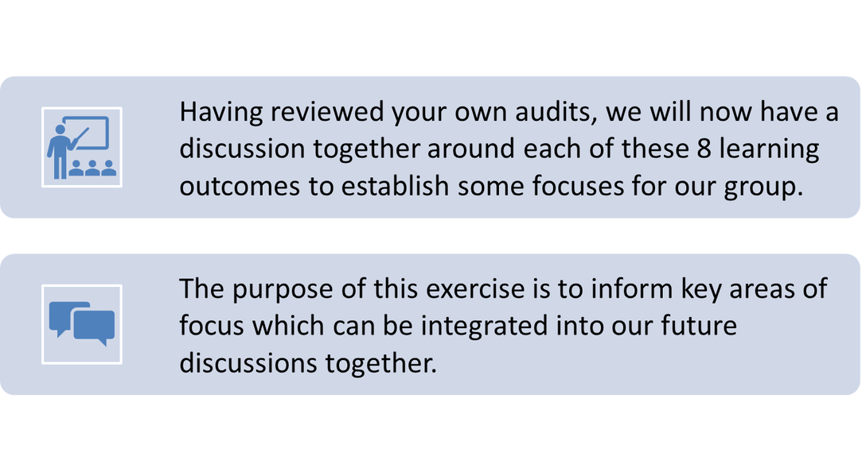
Assessing the Department for Education’s 8 Learning Outcomes: Group Activity
Notes:
Within this next activity, we will be reviewing your responses in the audit and action plan sections of the core workbook.
for quiet groups-these questions may help to scaffold the discussion?
1. What areas on your audits did you rate as not started or not in place?
2. Were there any ideas which you have recorded into your action plan sections yet in the core workbook?
3. What are the main areas we need to focus on as a circle?
for chatty groups:
Support them in understanding that this is just an initial discussion and there will be other opportunities to continue with this work.
Try to steer them towards getting something down about each of the 8 learning outcomes in terms of what needs to happen next.

Slide 17

Mapping Provision
Mapping refers to the processes of establishing school/college based and external services both locally and nationally.
These may be statutory, non-statutory.
It is crucial that we have information at our fingertips and that staff are kept abreast of developments in relation to the services that are available.

Slide 18
Think, Pair, Share of Services
What is available in your setting?
What is available in your local areas?
What is available nationally?
Remember:
A whole organisation approach includes staff, parents & carers, young people and the local community

Slide 19
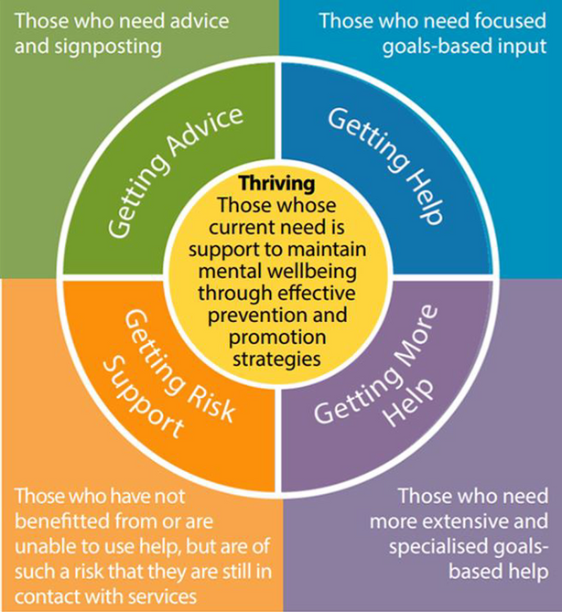
The Thrive Model
Notes:
For those whose current need is support in maintaining mental wellbeing through effective prevention and promotion strategies. ‘Thriving’ includes population health and wellbeing promotion, universal prevention, and selective prevention.
Getting Advice: Those who need advice and signposting
Within this grouping are children, young people and families adjusting to life circumstances, with mild or temporary difficulties, where the best intervention is within the community with the possible addition of self-support.
This group may also include, however, those with chronic, fluctuating, or ongoing severe difficulties, for which they are choosing to manage their own health and/or are on the road to recovery.
Getting Help: Those who need focused goals-based input
This grouping comprises those children, young people and families who would benefit from focused, evidence -based help and support, with clear aims, and criteria for assessing whether these aims have been achieved.
Interventions are characterised by an explicit shared understanding from the outset of:
· What a successful outcome would look like
· How likely this is to occur by a specific date
· What would happen if this was not achieved?
Getting MORE Help: Those who need more extensive and specialised goals-based help
This grouping also comprises those children, young people and families who would benefit from focused, evidence-based interventions, with clear aims, and criteria for assessing whether these aims have been achieved.
There are no hard and fast rules as to who needs ‘More Help’ but the following are frequent indicators:
· The child or young person is completely unable to participate age appropriately in daily activities in at least one context (eg. Schools, home, with peers)
· They may even be unable to function in all domains (eg. Staying at home or in bed all day without taking part in social activities)
· They need constant supervision (due to their level

Slide 20
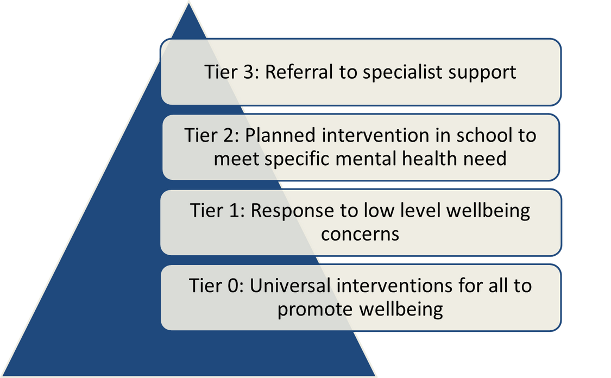
The Tier Model of Intervention Mapping

Slide 21
Provision Mapping
Group Activity
Before next time, you will need to create your own draft of a provision map
In your groups:
Select whether a Thrive Model or Tier Model is preferable
Consider your reasons
Once you have completed your provision map before day 2, who will you then be sharing it with?
Notes:
Point out that there are other approaches but these are just two…it is permitted for them to present their map in anyway they choose to….show examples

Slide 22
Spotting the Signs:
Essential Information
Although there are many mental health diagnoses, it is not our role to diagnose.
We will take you through three of the most prevalent areas today so that you can be aware of them.
Anxiety
Depression
Trauma

Slide 23

“A trauma-informed educator never forgets that children bring their entire lives into the classroom every day, and that on some days, children will be actively responding to trauma”.
(Perkins & Graham-Bermann, 2012)

Slide 24
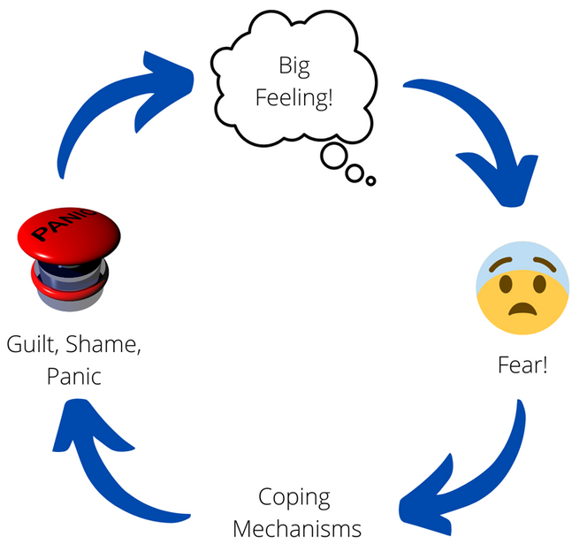
The Feelings Cycle
Notes:
These factors can have an impact on performance at school. Find out the ideas of the group as to how.

Slide 25
Spotting the Signs:
Anxiety
CYP who experience anxiety often see threats or dangers as being much greater than they actually are e.g. disproportionate worry.
Those with anxiety may try to manage difficult situations by avoiding the situation or relying on an adult to deal with it for them.
This avoidance reinforces their belief that they cannot cope, blocks opportunities to develop helpful skills and ultimately ends up making them feel more anxious in the future; it can be a vicious cycle.
Normalising anxiety symptoms helps to regulate emotions and build resilience.

Slide 26
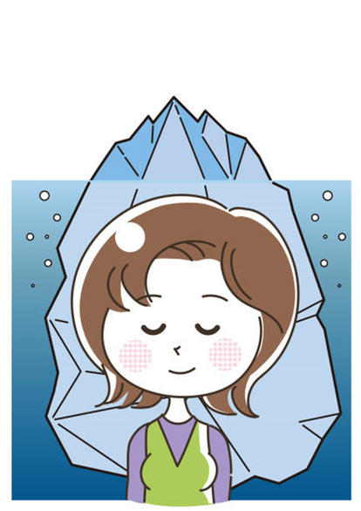
Spotting the Signs:
Depression
Tearful
Withdrawn from friends and/or family
No longer enjoying hobbies
Unable to concentrate
Sadness
Tired all the time
Poor communication

Slide 27
Spotting the Signs:
Depression
Feeling hopeless or helpless
Irritable/Angry
Lack of motivation
Anxious
Changes in eating or sleeping habits
Neglect of appearance and/or hygiene

Slide 28
Some examples of ACEs
Domestic violence
Parental loss through separation, divorce or death
A parent with a mental health condition
Experiencing abuse (physical, sexual and/or emotional)
Experiencing neglect (physical and emotional)
A member of the household being in prison
Parents/carers with alcohol and substance use problems

Slide 29
Spotting the Signs:
Trauma
(These may indicate PTSD or CPTSD in adults)
Difficulty focusing, attending, retaining, and recalling
Missing classes
Challenges with emotional regulation
Fear of taking risks
Anxiety about deadlines
Anger, helplessness, or dissociation when stressed
Withdrawal and isolation
Involvement in unhealthy relationships

Slide 30

Group Discussion:
Prevalent Mental Health Concerns
On your tables, consider any other areas you would like to discuss on day 2 e.g. addiction.
We will have limited time but can provide additional resources to support discussions.

Slide 31

Each Journey is Unique
Two people can have the same diagnosis but have a totally different story.
Important we recognise that the cycle gives an idea of how to understand what is happening but it is important that we always see the young person in front of others and not make assumptions.

Slide 32
Mental Wellbeing
Your whole staff team wont need to know all of the spotting the signs.
They need to know what wellbeing is and how to spot change in CYP.

Slide 33
Identifying children at risk
Two key elements that can enable schools to reliably identify children at risk of mental health problems:
Effective use of data An effective pastoral system
How do you currently identify children/young people who are at risk?
Notes:
Two key elements that can enable schools to reliably identify children at risk of mental health problems:
Early intervention tools
Effective use of data so that changes in pupils’ patterns of attainment, attendance or
behaviour are noticed and can be acted upon; along with
An effective pastoral system
When schools suspect that a pupil is having mental health difficulties, they should not delay putting support in place, using the graduated response process :
• an assessment to establish a clear analysis of the pupil’s needs; • a plan to set out how the pupil will be supported; • action to provide that support; and
• regular reviews to assess the effectiveness of the provision and lead to changes where necessary.
Link to KCSIE!

Slide 34
Some useful resources
Education Endowment Foundation – The Sutton Trust-EEF Teaching and Learning Toolkit is a summary of research, providing guidance for schools on using their resources to improve attainment of pupils especially disadvantaged pupils.
CORC outcome and experience measurements – provides easily accessible resources to measure children and young people’s mental health and wellbeing
Good Childhood Wellbeing Index - easy and free assessment of children’s well-being in the classroom.
Measuring and monitoring children and young people's mental wellbeing: a toolkit for schools and colleges – a range of validated tools to measure mental wellbeing amongst pupils
Let’s consider the implications of: Mental health and behaviour in schools:
https://assets.publishing.service.gov.uk/government/uploads/system/uploads/attachment_data/file/1069687/Mental_health_and_behaviour_in_schools.pdf

Slide 35
Using Evidence Based Measures/Measuring Outcomes
Designed to focus more on assessing targeted and specialist mental health needs.
Can also be used to measure the effectiveness of intervention.
Examples: Could you do a survey before and after your staff training sessions? (this is called a pre-post measures approach)
Measuring pupil wellbeing through something like the Stirling Children’s Wellbeing Scale? When would be appropriate to do that?
Notes:
Use this slide as a basis to discuss what evidence based measures are for. Designed to focus more on assessing targeted and specialist mental health needs.
Can also be used to measure the effectiveness of intervention.
Refer to their small intervention projects.

Slide 36

Wellbeing Measurement Framework
The Wellbeing Measurement Framework (WMF) is a suite of measurement booklets for primary school, secondary school and college students.
Each booklet contains a set of validated questionnaires that assess constructs such as positive wellbeing, behavioural or emotional difficulties, the presence and strength of protective factors and ability to deal with stress and manage emotions.
https://www.annafreud.org/schools-and-colleges/resources/wellbeing-measurement-framework-for-schools/

Slide 37
Pupil Mental Health
What does it mean to have mental wellbeing and how can we support?
Train The Trainer
Notes:
https://www.creativeeducation.co.uk/courses/descriptions-for-pupil-mental-health-when-to-worry-and-what-to-do-next/ This is the link to access this as an on demand version which totals 17 minutes and can be used in staff briefings with opportunity for discussion afterwards. This is designed to be a very basic session to go over the difference between mental health and wellbeing and some of the simple steps which you may wish to deliver to pockets of your staff. It could also be useful to use with parents, carers and young people with some adaptations.

Slide 38

Aims of the Session
To identify what wellbeing refers to
To explain the mental health continuum
To outline vulnerability
To consider some simple ways to promote mental wellbeing
To identify when to intervene

Slide 39

Group Discussion
What does the word wellbeing encompass?

Slide 40
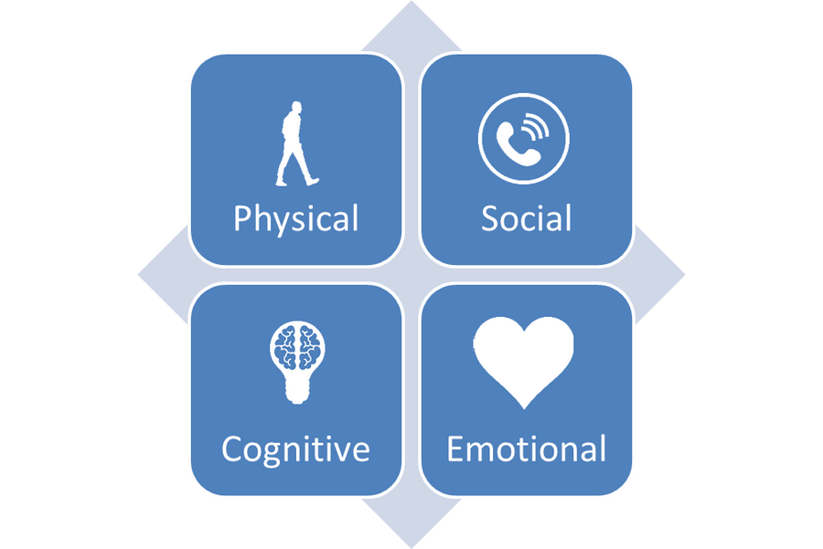
What is Wellbeing?
There is no health without mental health.
Notes:
Health and Wellbeing refers to a whole umbrella of areas which includes physical, cognitive, social, and mental wellbeing. Without mental health we do not have health. Wellbeing and a general sense of being well can enable both students and staff alike to be able to have fulfilment in their lives.
Health and wellbeing is also about ensuring that pupils are able to make the most of their educational opportunities regardless of their background or financial circumstances and through promotion of attendance at school.

Slide 41

What is Wellbeing?
Mental wellbeing does not refer to people who do not have mental illnesses.
Mental wellbeing is an indication of how well a person is from a social, emotional and physical perspective.
Many things impact our mental wellbeing.
Mental wellbeing can be defined as feeling good, feeling that life is going well, and feeling able to get on with daily life.
What might influence our wellbeing?
Notes:
Health and Wellbeing refers to a whole umbrella of areas which includes physical, cognitive, social, and mental wellbeing. Without mental health we do not have health. Wellbeing and a general sense of being well can enable both students and staff alike to be able to have fulfilment in their lives.
Health and wellbeing is also about ensuring that pupils are able to make the most of their educational opportunities regardless of their background or financial circumstances and through promotion of attendance at school.

Slide 42
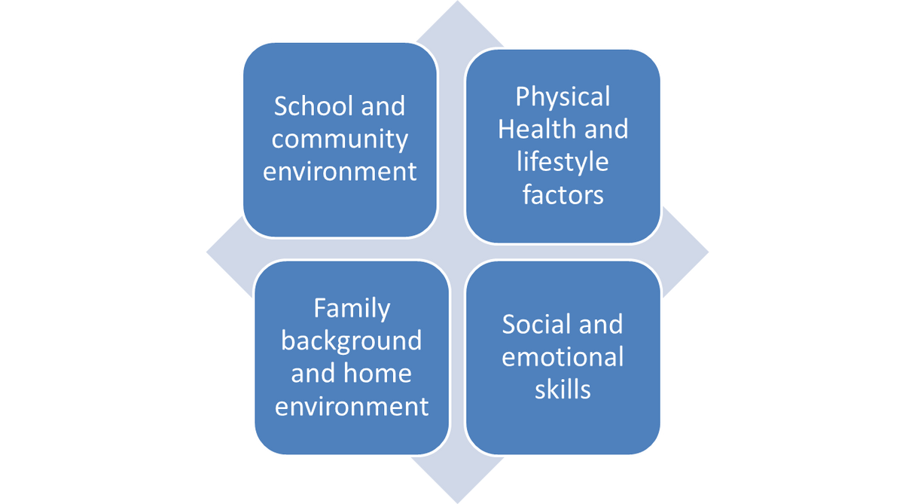
Four influences of our Wellbeing
Notes:
Coach prompt: How might these things have an impact on us?

Slide 43
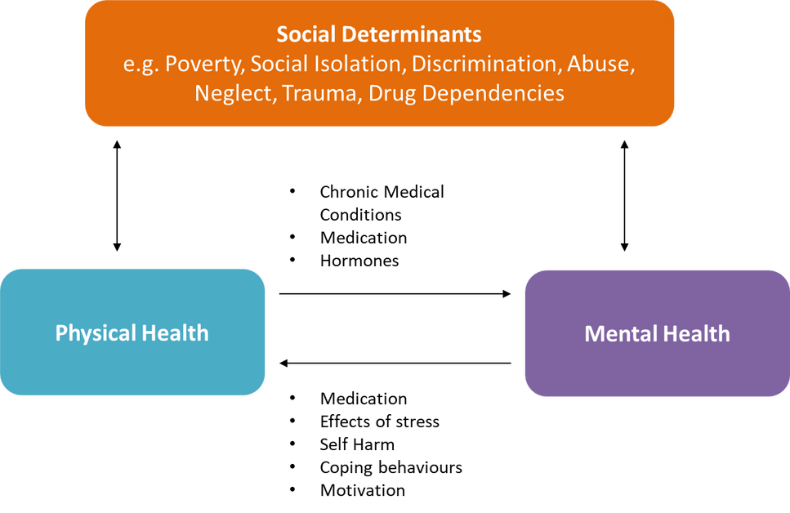
Why is mental wellbeing important?
Notes:
The diagram illustrates that mental health and physical health are inter-linked. Chronic stress for example has been found to effect the immune system or the excessive use of substances such as tobacco can have varying impacts on physical health. In turn, the social wellbeing of an individual also underpins how well they can thrive, reach their full potential and also stay physically well. This includes things like safe housing and green spaces to play. We can see the links between all of these components. Together they can inform how well an individual is as well as informing their future.

Slide 44

Mental Wellbeing Continuum
Notes:
The mental wellbeing continuum shows that we can slide between positive/optimum wellbeing through to mental ill-health which will have an impact on the daily lives of the individual.
The green section reflect that is seen as healthy. It is healthy to experience changes in our moods, have a regular sleep pattern, be psychically and socially active and to deal with some stress.
The yellow reflects an individual who is experiencing some reversible distress. We might look out for irritability, increased nervousness or worrying, trouble sleeping (falling asleep in class), changes to social activity levels. It is normal to experience some reversible distress or fluctuations away from our usual functioning particular in light of stressors (big life events such as moving house).
Orange is referred to as significant functional impairment which is a complicated way of saying that the individual may be starting to struggle with coping, their usual coping strategies may not be working and it is starting to effect their daily functioning.
Red is referring to an individual who crossed over into mental ill-health. That means that they will be out of their depth and unable to cope. We will see significant changes in their thoughts, feelings, behaviours. They may be experiencing severe symptoms and will need support from professionals.

Slide 45
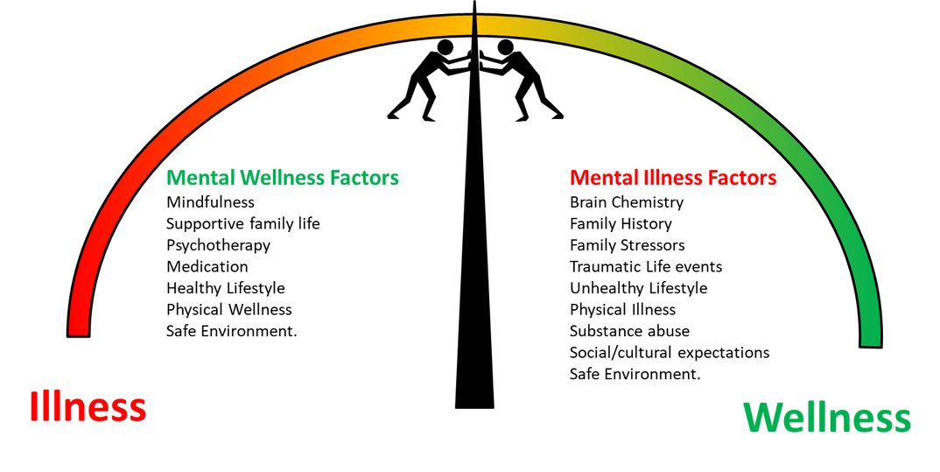
How do we move on the continuum?
Notes:
We can see here that essential life functions individuals should be able to carry out if they have mental wellbeing. For example, young people can have good connections with their peers, they will be able to complete schoolwork to the best of their ability, they can carry out day-to-day tasks which fit with their age such as taking care of their personal hygiene.
Those who are struggling with their mental wellbeing or who might be experiencing mental ill-health may be experiencing a range of difficult life events such as trauma, they may have unhealthy coping mechanisms such as addiction or experiencing biological changes in the brain.
We talk more about what we need to look out for in the vulnerability section.

Slide 46
Summary
Mental health is everyone’s responsibility.
We need to remember that some fluctuations in moods, emotions and feelings is normal.
It is also normal to experience the full range of emotions especially when faced with significant life events.
Early intervention is key to keep as many people as close to the green side of the continuum as possible. This might be through providing support in school or signposting to external support services such as Kooth or The Mix.
Individuals who are experiencing a deterioration in their day-to-day functioning will need professional support.
Notes:
Some young people won’t feel comfortable talking with school or family about their feelings. It that situation you could recommend:
Kooth have online discussion boards, an online opportunity for young people to share coping strategies and so on as well as a live messaging feature for online conversations with professionals.
The Mix provide free and confidential support to the under 25’s about a range of topics.

Slide 47


Pause for thought!
How can we help those around us to stay in the healthy and coping section as much as possible?
Notes:
Some young people won’t feel comfortable talking with school or family about their feelings. It that situation you could recommend:
Kooth have online discussion boards, an online opportunity for young people to share coping strategies and so on as well as a live messaging feature for online conversations with professionals.
The Mix provide free and confidential support to the under 25’s about a range of topics.

Slide 48
Vulnerability

Slide 49
What is Vulnerability?
Vulnerability within the mental health context refers to the likelihood of an individual developing a mental illness.
Exposure to risk factors can increase an individual’s vulnerability whereas protective factors can minimise the effect that risk factors.
Notes:
Health and Wellbeing refers to a whole umbrella of areas which includes physical, cognitive, social, and mental wellbeing. Without mental health we do not have health. Wellbeing and a general sense of being well can enable both students and staff alike to be able to have fulfilment in their lives.
Health and wellbeing is also about ensuring that pupils are able to make the most of their educational opportunities regardless of their background or financial circumstances and through promotion of attendance at school.

Slide 50
Risk Factors
The risk factors of each mental illness do differ and there are many but here are some of the main ones to look out for:
Environmental risks
Family risks
Individual risks
What might be included in these three categories?
Notes:
Coach prompt: Some ideas for quieter groups…
Environmental risks:
Poverty
Natural disasters, war and violence in the community
Refugees/asylum seekers
Homeless
Family risks:
Attachment difficulties
Parental conflict
Family breakdown
Witnessing domestic violence
Abuse and neglect
Parental illness (mental and physical)
Inconsistent discipline and expectations
Individual risks:
Genetics/inherited illnesses
Developmental delay, low IQ
SEND
Communication difficulties
Low self-esteem
Poor attendance and academic achievement
Those experiencing stigma and discrimination e.g. with regards to protected characteristics such as gender, sexuality, ethnicity, religion, disability etc.

Slide 51
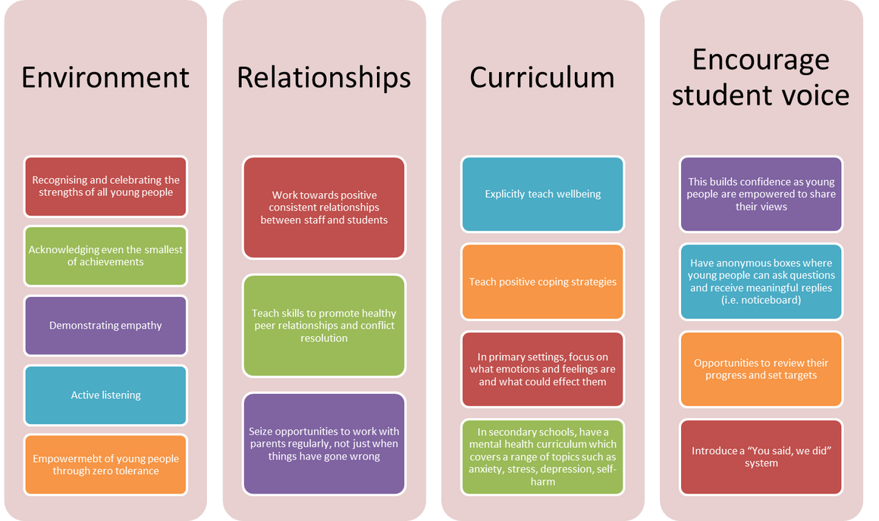
Positive organisation cultures can reduce vulnerability
Notes:
We are well-placed as educators to decrease vulnerability and contribute to the protective factors which can help to keep everyone on the healthy side of the continuum.

Slide 52
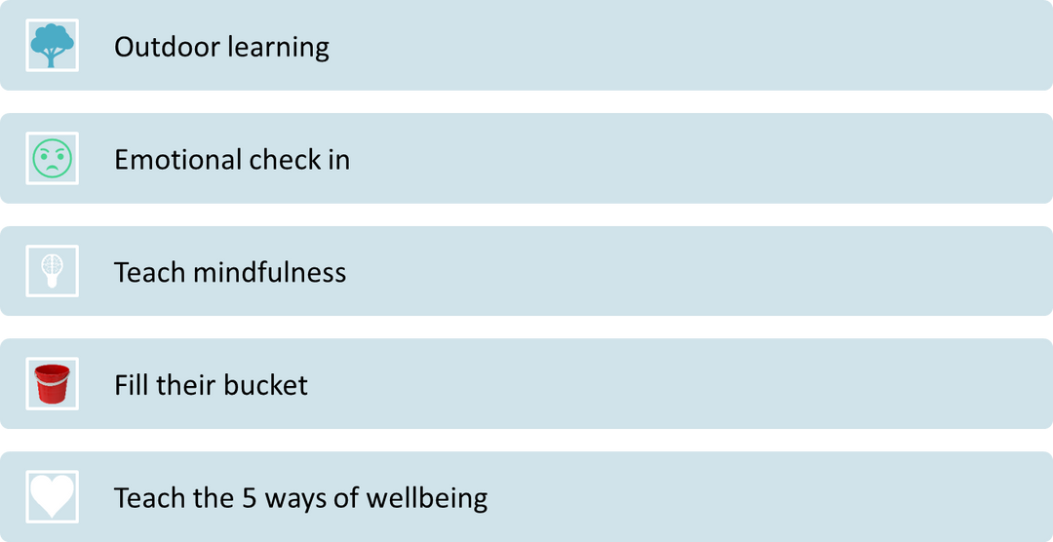
Simple ways to promote mental wellbeing (primary)
Notes:
Learning outdoors and being nature has strong links with mental wellbeing. It helps children to problem solve for themselves which can enhance self-esteem and confidence. It can encourage team working and strong connections with other children in the class.
At the start of the day, have an emotional check in every class where every child can note down or indicate how they are feeling and why. This will help to normalise discussions around feelings, emotions and mental health generally.
Mindfulness refers to the power of being present in the moment-a time to take a breath and pause from the busy school day. Some schools have found techniques such as buddy breathing useful (script included final slides).
Ensure every child knows the ‘5 Ways to Wellbeing’ which are to ‘Connect,’ ‘Be Active,’ ‘Take Notice,’’ Keep Learning’ and ‘Give.’ Provide regular opportunities for this to happen in the school day.
Fill their bucket refers to gratitude. This can be done in several ways but might start with children drawing their own bucket and labelling it with things that they are grateful for.

Slide 53
Simple ways to promote mental wellbeing (secondary+)
Peer mentoring/circle of friends
Teaching resilience
Consider calming strategies and key principles of self-care
Teach help-seeking
Notes:
Peer mentoring/peer listeners is an easy system to set up with some staff supervision. It can provide opportunities for young people to talk through their concerns with a peer which is something that many young people prefer. It is useful in situations of lower-level distress and can be a way of flagging up more serious concerns. The mentors will need some training around not promising to keep secrets if someone is in danger and how to report concerns to members of staff.
Teaching resilience: Resilience is the capacity to adapt well when faced with adversity or stress. Resilience helps students stave off potential negative psychological effects of challenging experiences. Resilience involves more than continuing to persist despite difficulty. Resilient students interpret academic or social challenges in a positive way (such as increasing effort, developing new strategies, or practising conflict resolution). We can look into many different factors that affect resilience: • secure early attachments • confidence of being loved and valued by one’s family and friends • clear sense of self-identity (personal, cultural and spiritual) • sense of self-efficacy (being able to make decisions and act independently) • confidence to set goals and attempt to achieve them.
Ask children “What are you saying to yourself?” and “What are you thinking inside your head?”, and if necessary, help them to reframe these thoughts. Teach students to think “What’s wrong with this situation?”, not “What’s wrong with me?” or “Why me?”.
Schools can help by trying to encourage good relationships with friends, teachers and other members of staff. It is important that students have somewhere they feel they belong (clubs, activities and favourite places in school) and that they meet people who are good influences, who can help them make sense of where they have come from and their place in the world.
Helping your students to develop talents, interests and life skills, encouraging them to learn h

Slide 54
When to Intervene

Slide 55

When to intervene,
and what to do next...
We need to spot change within a young person and be curious about those changes.
We need to decipher where a young person might be on the continuum and the level or risk they are in.
There is lots that we can do in school for young people experiencing difficulties such as loss and bereavement, exam stress and more.
Notes:
For more information on referrals, please access the referral training pathway.
*CAMHS-Child and Adolescent Mental Health Service

Slide 56
When to intervene,
and what to do next...
We need to ‘watchfully support’ all young people that we have concerns about, monitoring their day-to-day coping and how long they are experiencing the difficulties.
In situations of medium risk or individuals in the orange zone of the continuum, we will want to start to use a range of voluntary/specialist organisations to provide further support, making use of in-school counselling or other in house offers.
For individuals in high risk, showing the signs of mental illness, significant self-harming or suicidal thoughts/intention, we will need to refer to CAHMS.
Notes:
For more information on referrals, please access the referral training pathway.
*CAMHS-Child and Adolescent Mental Health Service

Slide 57
Always remember safeguarding procedures and policies…
“Safeguarding and promoting the welfare of children is everyone’s responsibility. Everyone who comes into contact with children and their families and carers has a role to play in safeguarding children. In order to fulfil this responsibility effectively, all professionals should make sure their approach is child-centred. This means that they should consider, at all times, what is in the best interests of the child.”

Slide 58
Nothing about me without me…
Do students understand that we have a duty to share when we are concerned about them?
Don’t encourage students to disclose sensitive information in the classroom. Students should only share sensitive information in a suitable, one-to-one setting with an appropriate member of staff.

Slide 59

Reflection:
Train the Trainer
You may want to substitute the ‘promoting wellbeing’ slides for some of your own activities/strategies you have in your school… what could you include?
Who needs this training in your school?
Would your parents/carers benefit from an adapted version?

Slide 60
Pupil Voice
A whole school or college approach means listening to the voices of everyone in the school community.
This includes children and young people as well as parents and carers, and school staff.
Involving students in decisions that impact on them can benefit their mental health and wellbeing by helping them to feel part of the school, college and wider community and to have some control over their lives.
How can you ensure the views of all pupils and students are heard?

Slide 61
Teaching PSHE and Mental Health Safely
It is important for SMHLs to support teaching staff to develop safe lessons which provide equal opportunities for children and young people to develop their skills and knowledge.
What is taught in PSHE should be supported by all staff and not be the only time mental health and wellbeing are discussed in school.
Small group discussion:
How can you support your teaching staff?
What opportunities are there to get the whole school/college talking about mental health?
Notes:
What we teach in the classroom will help pupils foster lifelong aspirations, goals and values. With this in mind, PSHE education isn’t just another school subject. It’s a chance to give every child and young person an equal opportunity to develop the skills and knowledge they need to thrive and have resilience now and in the future. This includes helping them to deal with critical issues they face every day e.g. friendships, emotional wellbeing and change.
From making informed decisions about alcohol to succeeding in their first job, we know PSHE education helps pupils prepare for all the opportunities, challenges, life decisions and responsibilities they may face.
This in turn allows pupils to have better health and wellbeing and achieve better academically, and enjoy greater success personally and professionally.
All of this means that, when taught well, PSHE education is popular with pupils, parents and schools.

Slide 62
Teaching PSHE and Mental Health Safely
We need to particularly ensure we think about the needs of SEND learners as they may experience discussions differently.
How do you find ways to provide ‘bespoke’ curricula for this group?
Can these students be included into the typical class setting? – Should they be?
‘Puberty’ and ‘Adolescence’ have a significant impact on the delivery of this type of work; How will you consider framing that when considering the huge diverse spectrum of abilities in one classroom setting?

Slide 63
What mental health and wellbeing topics should be covered?
Working in phase specific groups e.g. primary, secondary etc, referring to the National Curriculum and PSHE Association guidance, what are the top priority topics for your young people?

Slide 64

What mental health and wellbeing topics should be covered? (Primary)
Explaining that there is a normal range of emotions (e.g. happiness, sadness, anger, fear, surprise, nervousness)
Recognise and talking about their emotions,
how to judge whether what they are feeling and how they are behaving is appropriate and proportionate.
the benefits of physical exercise, time outdoors, community participation, voluntary and service-based activity on mental wellbeing and happiness.

Slide 65
What mental health and wellbeing topics should be covered? (Primary)
Provide simple self-care techniques to try
How to seek support when we need to inside/outside of school
Discuss the effects of bullying (including cyberbullying) on mental wellbeing.
it is common for people to experience mental ill health but for many people who do, the problems can be resolved if the right support is made available, especially if accessed early enough.
Notes:
Organise Five Ways to Wellbeing assemblies Work with pupils to create whole school or year group assemblies to share the importance of looking after our mental health across the whole school.

Slide 66
What mental health and wellbeing topics should be covered? (Secondary)
how to talk about their emotions accurately and sensitively, using appropriate vocabulary.
that happiness is linked to being connected to others.
how to recognise the early signs of mental wellbeing concerns.
common types of mental ill health (e.g. anxiety and depression).
how to critically evaluate when something they do or are involved in has a positive or negative effect on their own or others’ mental health.
the benefits and importance of physical exercise, time outdoors,
community participation and voluntary and service-based activities on mental wellbeing and happiness.
Notes:
Organise Five Ways to Wellbeing assemblies Work with pupils to create whole school or year group assemblies to share the importance of looking after our mental health across the whole school.

Slide 67
Supporting your teachers
https://www.gov.uk/guidance/teaching-about-mental-wellbeing
https://www.gov.uk/government/publications/relationships-education-relationships-and-sex-education-rse-and-health-education
Provide support to teachers to ensure that they are empowered with the facts required to teach about mental health and wellbeing topics.

Slide 68
Supporting your teachers
It is good practice to:
Establish ground rules with classes for discussions
Give plenty of opportunities for view sharing
Ask it baskets or anonymous question boxes! (Some young people will be too afraid to task questions)
provide access to balanced information and differing views to help pupils clarify their own opinions (whilst making clear that behaviours such as racism, homophobia, bi-phobia, transphobia, discrimination and bullying are never acceptable in any form)

Slide 69
Supporting your teachers
Teachers should proceed with caution when expressing their own views due and be aware of the power balance.
Consider the school’s values, policies, law and ethos when planning lessons.
Plan for student’s carefully who have experience personally with a topic.
Ensure students understand the disclosure and safeguarding procedures and why they exist.
Remember, PSHE should fit into the whole school approach!

Slide 70
Future Planning
What does your teaching team require to teach mental health confidently?
How can you increase buy in of other subject specialist to realise their importance in the whole school approach?
What are your top 3 priorities this term?

Slide 71
Next Steps

Slide 72

What to do before
next time...
Review your audit and action plan (you will be sending us this after day 2)
Complete a draft provision map and bring it with you next time
Consider an area of your audit to base your Small Intervention Project on. See how far you get before day 2.

Slide 73
Small Intervention Project
Using the areas identified on your settings audit as requiring improvement, select one area as your focus to conduct a small intervention that you can measure the effectiveness of. By the end of the programme, with the support of your coach, you will create and deliver a 5-7 minute presentation which will be recorded and sent to us.
Step 1: Identify your area and clarify your outcome
Step 2: Choose your intervention (keep it simple!)
Step 3: Plan your intervention

Slide 74

Support Available
Email support is available from your Trainer.
For general enquiries e.g. login issues, access to resources, email
happytohelp@creativeeducation.co.uk

Slide 75

Goals!
Working independently, jot down four things that you are going to do as a result of this session.
We will share these when ready.
Notes:
Coach prompt:
Now that we have found out a little more about where we sit as a circle against the outcomes, lets think to the future. Working independently, can you think of something you will do this week, next month, next term and next year as a result of our discussion. In a few minutes, we will discuss these together. Think about small, achievable things.
Coach NB: The purpose here is to help your circle to understand that we are planning for the longer term... Whilst there are undeniable some ‘quick wins,’ they need to start thinking about the longer term goals and the steps that are needed to inform a complete whole school approach to MH.

Slide 76

Your own wellbeing
Matters too!
Next time we will talking about staff wellbeing.
Before next time, have a think about what you can do for you to keep you batteries topped up so that you can safely support others.

Slide 77
Feedback Survey
Please complete this short survey
https://survey-eu1.hsforms.com/1n7KhqfzpRBOFyPM1QePZ4w5kw04
We look forward to seeing you again on Wednesday 9th July ☺

