Slide 1
Welcome to Creative Education’s Senior Mental Health Leads 2-Day Intensive Online Course Training (Day 2)

Slide 2

General Housekeeping
Notes:
Mention fire safety
Toilets
Breaks/refreshments
Mobile phones

Slide 3

Group Agreement
As we all have our own life experiences, mental health statuses, relationships with others and more, it is important we can create a safe space.
What needs to be on our group agreement to make this happen?
Notes:
Listen to each other​
Show respect​
Celebrate diversity in all of its forms​
Don’t refer to young people by their names​
Examples shared stay within our group but learning should be shared as widely as possible​

Slide 4

Trigger Warning
We will be talking openly about mental health do take time out and let us know if we can support you in anyway.​

Slide 5
Reflections
On your tables, please consider any questions you are bringing into the session that you would like us to cover today.
What have you achieved since last time and what is left to do?

Slide 6
Provision map progress
In your groups, reflect on:
The usability of your maps
Are there any national services you can trade to add to your maps?
Who do you need to share these with next?
Have you thought about parents & carers and staff?
Notes:
Remind participants that there are some example provision maps on the website.
https://www.annafreud.org/on-my-mind/youth-wellbeing/
The Mentally Healthy Schools Workbook by Dr Pooky Knightsmith
Islands in the Stream: Senior Mental Health Leads in Schools Rachael Bushby & Claire Pass

Slide 7
Importance of Parent and Carer Engagement
Ensure there is an area on your college/ school website which parents can access to get information about in college / external agency support if their child is struggling with their mental health
Host a parent’s information evening inviting local support services in to show they support they are able to offer
Create an online parents survey to assess how they feel about the colleges current provision/ systems for mental health.
What might prevent parents and carers from engaging?
Notes:
Parent and Carer Engagement:
https://mentallyhealthyschools.org.uk/whole-school-approach/parentcarer-engagement/
https://www.youngminds.org.uk/media/h4uexcw1/ym-parent-carer-toolkit-2020.pdf
Signposting for Parents and Carers:
Charlie Waller PLACE network https://charliewaller.org/place-parent-support/
Young Minds https://www.youngminds.org.uk/parent/
Academic Base:
Martin F, Dahmash D, Glover S, et al
Needs of parents and carers of children and young people with mental health difficulties: protocol for a systematic review
BMJ Open 2023;13:e071341. doi: 10.1136/bmjopen-2022-071341
https://educationendowmentfoundation.org.uk/public/files/Publications/ParentalEngagement/Parental_Engagement_-_Evidence_from_Research_and_Practice.pdf
https://www.gov.uk/government/publications/how-to-set-up-your-start-for-life-parent-and-carer-panel-local-authority-guidance/establishing-your-parent-and-carer-panel

Slide 8
Supporting Parents and Carers who have a child experiencing mental health concerns
“Keep reminding yourself that you didn't cause this; there are so many inputs into young people lives now that we're not actually in control of. So, I think it's really important that parents see themselves not as the kind of controller of their child's mental health and wellbeing, but actually a facilitator for positive wellbeing.”
Suzanne Alderson, author of Never Let Go: How to Parent Your Child Through Mental Illness
Notes:
Suzanne Alderson, author of Never Let Go: How to Parent Your Child Through Mental Illness https://www.mentalhealthtoday.co.uk/blog/parental-mental-health/how-to- support-yourself-and-your-child-through-mental-illness
Parent and Carer Engagement:
https://mentallyhealthyschools.org.uk/whole-school-approach/parentcarer-engagement/
https://www.youngminds.org.uk/media/h4uexcw1/ym-parent-carer-toolkit-2020.pdf
Signposting for Parents and Carers:
Charlie Waller PLACE network https://charliewaller.org/place-parent-support/
Young Minds https://www.youngminds.org.uk/parent/
Academic Base:
Martin F, Dahmash D, Glover S, et al
Needs of parents and carers of children and young people with mental health difficulties: protocol for a systematic review
BMJ Open 2023;13:e071341. doi: 10.1136/bmjopen-2022-071341
https://educationendowmentfoundation.org.uk/public/files/Publications/ParentalEngagement/Parental_Engagement_-_Evidence_from_Research_and_Practice.pdf
https://www.gov.uk/government/publications/how-to-set-up-your-start-for-life-parent-and-carer-panel-local-authority-guidance/establishing-your-parent-and-carer-panel

Slide 9
Discuss at your tables what you currently do within your school/college setting to enable children/YP to feel safe and thrive
Nominate spokesperson to feedback
Notes:
5 mins

Slide 10
Why staff training?
Whole organisation approach requires all staff irrespective of role to have baseline knowledge.
We will demonstrate a model to you but you must make this bespoke to gain full staff buy in.
Adapt it depending on your audience, skills and abilities.
Adaptable in terms of delivery, context and content.
However, as discussed on day 1, you need to make sure that you measures the knowledge and confidence of staff before and after.
What would you implement if scores did not increase?
Notes:
Academic Base:
Anderson, M., Werner-Seidler, A., King, C., Gayed, A., Harvey, S. B., & O’Dea, B. (2019). Mental health training programs for secondary school teachers: A systematic review. School Mental Health, 11, 489-508.
Future in Mind
School culture and student mental health: a qualitative study in UK secondary schools (2022)

Slide 11
Mental Health and Behaviour (2018)
This policy serves as a useful reminder to:
Promote good mental wellbeing for all
Promote resilience
Clear expectations promote safety
Early intervention helps to create calm environments where young people feel safer in school.
Does your behaviour policy cover these aspects? How does it relate to your mental health and/or safeguarding policies?
https://www.gov.uk/government/publications/mental-health-and-behaviour-in-schools--2
Notes:
Key points to raise:
“Schools have a central role to play in enabling their pupils to be resilient and to support good mental health and wellbeing. It is important that schools promote good mental wellbeing for all pupils.”
“A school’s approach to mental health and behaviour should be part of a consistent whole school approach to mental health and wellbeing. This should involve providing a structured school environment with clear expectations of behaviour, well communicated social norms and routines, which are reinforced with highly consistent consequence systems. This should be paired with an individualised graduated response when the behavioural issues might be a result of educational, mental health, other needs or vulnerabilities.”
“There are things that schools can do for all pupils, as well as those at risk of developing mental health problems, to intervene early to create a safe and calm educational environment and strengthen resilience before serious mental health problems occur.”

Slide 12
Equality and Diversity Act (2010)
Working in groups, consider one of the following:
Group 1:What are the key responsibilities around mental health and the Equality and Diversity Act (2010)?
Group 2: How can we promote the inclusion of all children and young people? (you might want to consider ethnic or social background, in terms of academic ability, neurodiversity, being from financial disadvantage, having English as an additional language or a special educational need and/or disability.
Group 3: What can you do to ensure all staff know that equality and diversity must be embedded throughout the curriculum?
Group 4: What community factors might need to be considered as part of equality, diversity and inclusion?
https://www.gov.uk/guidance/equality-act-2010-guidance
Notes:
Building pupils’ sense of belonging and ensuring everyone feels safe within the school
Every child and young person must have an equal opportunity to develop the skills and knowledge they need to thrive and have resilience now and in the future
Acknowledge and celebrate the positive impact of diversity within year groups
Deliver dedicated assemblies and tutor time activities stressing the school’s shared values of inclusion, tolerance, kindness, care and unconditional respect for members of the school and wider community.
Understand the impact of discrimination on pupil wellbeing and mental health, remaining alert to our own bias and the impact of power dynamics between dominant and minority groups. This includes having an awareness of how intersectionality(aspects of a person's social and political identities combine) can create different modes of discrimination and priviledge.
Provide inclusive and accessible support systems, ensuring that access to counselling, mentoring and external agencies reflect the diversity within our community.

Slide 13
Train the Trainer: Enabling children and young people to feel safe so they can thrive
Notes:
Coach prompt:
Hello and welcome to this train the trainer session. This presentation has been put together with the intention of you and your team developing and adapting the content to meet your needs. The overarching message is that young people can not thrive, they can not reach their full potential or hit their target grades if they do not feel safe and valued in their environment.
Academic Base:
Promoting mental health and well-being in schools: examining mindfulness, relaxation and strategies for safety and well-being in English primary and secondary schools-study protocol for a multi-school, cluster randomised controlled trial (2023)
Jessiman, P., Kidger, J., Spencer, L., Geijer-Simpson, E., Kaluzeviciute, G., Burn, A. M., ... & Limmer, M. (2022). School culture and student mental health: a qualitative study in UK secondary schools. BMC public health, 22(1), 619.
Norwich, B., Moore, D., Stentiford, L., & Hall, D. (2022). A critical consideration of ‘mental health and wellbeing’in education: thinking about school aims in terms of wellbeing. British Educational Research Journal, 48(4), 803-820.
Weiner, J., Francois, C., Stone-Johnson, C., & Childs, J. (2021, January). Keep safe, keep learning: principals' role in creating psychological safety and organizational learning during the COVID-19 pandemic. In Frontiers in Education (Vol. 5, p. 618483). Frontiers Media SA.
Wilson, C., & Cariola, L. A. (2020). LGBTQI+ youth and mental health: A systematic review of qualitative research. Adolescent Research Review, 5, 187-211.

Slide 14
Introduction
Safety is fundamental to the wellbeing of children and young people.
It goes far beyond the buildings and facilities but is the essence of creating a culture and ethos which enables young people to thrive.
Group discussion: How do we meet the physical, social, emotional and cognitive needs of young people in our school?
Notes:
Trainer memo: Use this discussion to gauge a baseline for the understanding of your school staff.

Slide 15
Physical Safety

Slide 16
What is physical safety?
When we think of health and safety, it’s physical safety that usually springs to mind and this is not a trivial issue.
Children need to know that they are physically safe, that they are not going to face danger and that the worry of physical safety sits with their trusted adults.
We can do numerous risk assessments, have health and safety visits in school and more which deem the young people to BE safe but do they FEEL safe?
Some young people, such as those who have experienced trauma, will be used to not feeling safe.
What can we do to change their perceptions?

Slide 17
Group discussion: How can we help a child to feel safe?
Notes:
Some ideas to help quieter groups:
Reassurance-how can we reassure a child?
Give them time to unlearn old habits-they may not have had the opportunity to feel safe. Think about a child you have worked with who felt unsafe or seemed to feel unsafe, how did you support them?
Show them, live it with them and enable this to embed over time.

Slide 18
Social Safety

Slide 19
Social Safety
This is often overlooked because as adults, we have often experienced most social situations.
However, for young people, we must hold in mind that they are learning the skills of socialisation.
The teenage years in particular can be a vulnerable time for many (e.g. peer pressure, a strong desire to fit in and be liked).
We may be able to relate to a child who hasn’t fully grasped how to behave socially yet by thinking about an unfamiliar situation to us.

Slide 20
Unfamiliar situations
Think back to a time when you:
Visited a country and didn’t speak the language or understand the customs
Went to someone’s house for the first time
Management changes at work
How did it make you feel?
Notes:
Trainer memo: Lets spend a few minutes now thinking back to a time when you were faced with something unfamiliar...how did it make you feel? What feelings might be experienced by an unsafe child?
Trainer NB: The group are likely to express feelings of apprehension, panic, uncertainty, feeling vulnerable… Explain that these are feelings that children who feel unsafe socially feel almost all of the time.

Slide 21
Social safety school provision
Think, Pair, Share
As an organization what do we do to support all children to feel safe socially?
What is working well?
What needs to be refined further?
Notes:
Trainer NB:
Use this slide to develop your own activity around social safety or develop this activity to suit your needs as a school.

Slide 22
How can we enhance feelings of social safety? Top tips
Communicate clearly in concrete terms
Use role plays/social stories
Support with change
Think from the perspective of the child
Teach the power of apology
What else can we add to this list? What has worked particularly well for you when communicating with children and young people who may need support socially?
Notes:
Trainer NB: the suggestions on this slide are deliberately not exhaustive. The idea is that as a trainer, we provide the foundations of the discussions, and then through questioning, enable the group to share their own suggestions. Ensure that all suggestions are entirely person centered (from the perspective of that particularly child/young person, informed by the context of the child/young person).
Trainer memo: Lets think together now about what we can to enhance the feelings of social safety in our school. This is especially important for children who did not attend nursery before school, those who may not have had much opportunity for peer to peer or adult communication.
Communicate clearly in concrete terms-there is a lot that we can learn from our communications and perhaps the way we might approach a child on the Autistic Spectrum. For example, communicating in concrete terms, helping them to understand. These are skills that can help everyone. Clear communication can significantly increase feelings of safety. Especially in situations that are novel or stress evoking.
Use role plays/social stories to teach them different social scripts and expectations.
Support with change-try to preempt changes where possible, have opportunities to discuss this and consider what with them any additional skills or strategies they can use to get through the change.
Think from the point of view of the child-do they know what to do? How to act? How to behave? If they don’t, how can they learn well? They are unlikely to pay attention fully to what we are teaching them. They may not gain enjoyment from being in school. Unstructured times such as lunchtimes might be particularly intimidating.
Help them to think about it…what questions can we ask to enable this?
Teach the power of apology-let the children or young people know that its ok to get things wrong, to misinterpret a situation or to unintentionally make someone feel uncomfortable. As long as we apologise and try if we can to learn why what we did made the other person uncomfortable, its ok. It is all part of learning.

Slide 23
Emotional Safety

Slide 24
Emotional Safety Overview
We need an environment where the child feels seen, heard and supported.
Where possible, we need to try our best to watch out for distress and embrace the opportunity to be present.
Presence needs to physical and emotional.
Emotional literacy can help young people to understand how to ask for help with their feelings, how to label their feelings so they can communicate clearly with us and know what to do if they feel a certain way.
Notes:
Trainer memo: They know their emotional needs will be at the centre of our school universe. We need an environment where the child feels seen, heard and supported.
Where possible, we need to try our best to watch out for distress and embrace the opportunity to be present.
This is sometimes difficult particularly if we have been working with someone for a long time and may have built up a strong rapport. As humans, we are programmed to run away from danger and distress, but we need to fight those instincts and embrace the uncomfortable to give them what they need. It is a powerful thing to be there for a young person who needs us and something that they are likely to remember for the rest of their life.
You might be one of the few people in their life that they feel comfortable with. To achieve this and demonstrate that we really are ‘there’ for the young person, our presence needs to be physical and emotional. So, literally we will be there with them, displaying through our tone of voice and body language a sense of acceptance and that they have our full attention. We need to validate those feelings and let them know that they are safe in the moment and can share what they need to with you.
Emotional literacy can help young people to understand how to ask for help with their feelings, how to label their feelings so they can communicate clearly with us and know what to do if they feel a certain way. It might be that for those who need it, we can use feelings cards, words, images etc. Sometimes we can just say the words such as ‘jealous, hurt’ so on. If we are working with non-verbal children, we can use the depth of touch to mean different things.
The real key is enhancing that relationship between both of you. It’s ok also to share your feelings with them about how a certain thing might make you feel. For example, ‘when I do exams or go to an interview...and how I cope with that is….’ You might have success also in helping them to understand facial expressions they might see or physical feelings they might experience such as a pounding heart when they are worried or feeling very hot when they are angry. This can help them to feel less scared of their feelings and emotions. Especially when we teach them to feel calm and give them a toolbox of strategies they can use when they feel a certain way.

Slide 25
Emotional Safety Discussion
Discussion: What can we do as educators or as a school more generally to help children and young people to understand how to calm themselves?
Notes:
Trainer NB: Use this question to shape your own activity or discussion.
Here are some suggestions-these have also been presented on the next slide so that if you have a quieter or more reluctant group, you can bring up that slide for an additional prompt.

Slide 26
Emotional Safety Discussion
What can we do as educators or as a school more generally to help children and young people to understand how to calm themselves?
Some suggestions:
Breathing techniques
Teach them to be in control of their feelings
Work with them to find out what can help them to feel calmer
Pizza massage technique

Slide 27
Encourage help-seeking
Demonstrate that its ok to ask for help through role modelling (which is different to sharing all of our own emotions, feelings and difficulties).
Praise those who ask for help.
Let them know that they don’t have to fix everything themselves.
When they do ask for help, show them exactly what we are going to do and why. It might be working with another adult. If that is the case, we must communicate this clearly to the child.
Notes:
Trainer memo:
One of the things that jeopardises emotional safety in young people is not know when or how to ask for help or even that it is ok to ask for help. Demonstrate that its ok to ask for help through role modelling. This might be though conversations we might have with young people about when we might ask for help and why.
Praise those who ask for help-give them the response that they need and see it though to the end.
Let them know that they don’t have to fix everything themselves and that help is most certainly a strength they will need in adult life to.
We want the child to share their emotional load with us so that we can make it lighter and free up more available space for learning and thriving. It is important that we do role model. However, we don’t want to say things that will make a child worried about us. Pick your examples carefully and try to think of things that the child can relate to.
So maybe we wouldn’t want to share a difficult personal situation that we were experiencing but we might perhaps think of a time when we did feel upset because our favourite mug smashed. These are the sorts of examples where we can still think about our own feelings without causing the child to worry about us.

Slide 28
Cognitive Safety

Slide 29
What is cognitive safety?
Cognitive safety is:
The encouragement that it is safe to try and learn
Children that can learn from their mistakes
Managing their expectations of themselves
We can explain that the learning happens we step outside of comfort zones.
We have to fail in order to learn.

Slide 30
Cognitive Safety-Lotus Blossom Task
Draw a grid on your paper or in a new document with 3 rows and 3 columns.
In the middle square, write the word Empowered.
Complete as many of the boxes as you can in response to the question:
What can we do to empower those in our school?
Notes:
Trainer NB: If your group are struggling to get started, you might want to think about children who can embrace failure, provide opportuntiies to take them out of their comfort zone.

Slide 31
Review of Lotus Blossom task
We may want to consider how we are providing opportunities for failure and then celebrating that failure in order to learn from it. What does this look like in our school?
Embrace our own failures and explain to them what our process of learning is.
If there are opportunities when the young people are better at something than we are (such as using technology?), let them teach us. This demonstrates that learning is truly lifelong.
Discuss your feelings out loud: “I am going to try this but I am a bit worried as I could get it wrong…” This shows young people that perseverance and having a go anyway is healthy.

Slide 32
Think about what we praise
Effort, perseverance, enquiry and learning behaviours are the things we should be praising, not just grades.
We need to think carefully about this and what we can do to praise in meaningful ways.
Create a fun learning environment which enables them to feel creative where possible.
If there are any specific interests that your classes have, we can try to get these into the curriculum.

Slide 33
Be inquisitive
If we do notice a child who does not seem to feel safe and is not enjoy learning we can:
Think about the barriers that are holding them back-e.g. not comfortable interacting, knowledge gaps which create fear, negative past experience etc.
If we can break these down over time, we will be able to make a significant difference.

Slide 34
Holistic activity
Think about a young person you have worked with previously who was perhaps reluctant to learn or could not embrace failure.
What would have supported this child to feel more safe?

Slide 35
Reflection
What are three things your partner learnt from this session?
Notes:
Coach Memo: Working in pairs, discuss your learning from the session. When prompted to do so, you will then share your partner’s three things to the group.

Slide 36
Discussion: Train the Trainer Session
How would you adapt the training to fit the needs of your setting?
Who needs this training and why?
What practical considerations do you need to plan for before delivering this session?
Any questions?
Notes:
Coach NB: The purpose of this slide is to help you to shape a discussion around the train the trainer session and help participants to get to a point when they will feel comfortable adapting it to their needs.
Coach prompt: now that we have gone through the slides on the Trainer the Trainer session, we will use these questions to prompt our discussion. Please do ask any questions you have because it is important that you feel confident with the purpose of the training and have some ideas for how you might need to adapt it.

Slide 37
How does this training package support you to create an ethos and environment which promotes mental health?
What else do you need to do next to work towards CYP FEELING safe?
Keeping Children Safe in Education: https://www.gov.uk/government/publications/keeping-children-safe-in-education--2

Slide 38
Some thoughts from a school and a young person…
“We wanted to create an environment where mental health wasn’t taboo. Where CYP could confidently raise concerns about themselves or a friend and where staff knew how to respond appropriately if they did”.
Notes:
School culture and student mental health: a qualitative study in UK secondary schools (2022)
Relate to the importance of this: The annual State of the Nation Reports

Slide 39
The Power of Young People in Colleges
“students are experts on the student experience”
https://www.aoc.co.uk/awards/blogs/the-power-young-people
Notes:
Anna Freud: https://mentallyhealthyschools.org.uk/whole-school-approach/pupil-voice/#:~:text=What%20is%20it%20and%20why,school%20staff%20about%20their%20experiences.
Association of Colleges: https://www.aoc.co.uk/awards/blogs/the-power-young-people

Slide 40
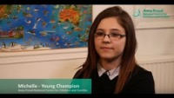
The Power of Young People in Schools

Slide 41
Some ideas from us
Select CYP to take part in a CYP voice group to understand emerging priorities for CYP mental health in your setting
Create a CYP survey about their mental health and wellbeing
Depending on the ability of those in your organization community, how might you need to adapt hearing their voices?
Ask yourself; How will CYP be involved in future intervention planning for your setting?
Notes:
The 2017 Green Paper Transforming Children and Young People’s Mental Health Provision

Slide 42

6. Enabling the Student Voice
Remember
There is no one way to promote the voice of children and young people
Every setting is different with unique cohorts.

Slide 43
Discuss at your tables how as a school/college you support distressed students
What would you say is key?
Notes:
5 mins

Slide 44
Talk to Distressed Students
(Train the Trainer)
Notes:
Trainer NB: Before adapting and considering delivering this training, think about who your target audience needs to be. There are notes to support you in the notes fields throughout.
The Designated Mental Health Lead Planner by Clare Erasmus
How to communicate with children and young people in distress BMJ, 2017
For parents: https://www.youngminds.org.uk/parent/how-to-talk-to-your-child-about-mental-health/

Slide 45
Introduction
Communication skills are fundamental when it comes to relationships between young people and staff.
We need to have open and honest conversations with those in our care.
Question: What might the barriers be that prevent us from having difficult conversations about mental health and wellbeing?
Notes:
Trainer prompt: You might expect to have your group suggesting that they are worried about doing or saying the wrong, perhaps physical barriers such as inappropriate private spaces or feeling that they don’t have the skills required. The purpose of this training is to help them to realise that absolutely anyone can have a conversation about mental health and help someone to feel less alone… Many of these concepts in this training can also be used with staff, parents and carers too.

Slide 46

Listen to understand
Activity: Working in pairs, think about a time when you really felt heard.
What did the listener do that made you feel that way? How did they help you to feel understood?
Notes:
Trainer prompt: You might want to urge a quieter group to think about body language, did the listener remain impartial/neutral… they were likely to focused in on them and not getting distracted by other things… They would have listened to understand rather than assume.

Slide 47
You can be the difference a young person needs…
We can create an environment where a child/young person really feels heard.
Young people often find it is better to be deeply listened to for even just 5 minutes…
Give them space-we don’t have to have the answers, simply listen and be with them whilst we share.
Try to not assume what they are going to tell you or how they might be feeling.
Notes:
Trainer prompt: Although it can often feel nerve wrecking when a young person approaches us telling us they have something to share, we can often rest assured that they are often coming to us to be heard. We don’t need to know the answers and often we can’t make the problem go away but we can be there for the young person. Try not to be afraid of silence. It may feel awkward but often this is really important processing time. Reassure them as much as you can by saying phrases such as, ‘there is nothing you could tell me that would make me think of you any differently.

Slide 48

Therapy Superpower
When having a conversation this week, practice being quiet for a minute… does the person you are conversing with try to fill the silence?
Notes:
Trainer prompt: if we don’t jump into the silence, they are likely to fill it themselves by continuing to share with you…physically tell yourself that you are going to allow a minute to pass to give them time to speak. If they aren’t going to speak, ‘would you like us to sit quietly for a little longer or would you like me to speak now?’ Find some words like this that work for you. All they need is someone to listen, support them and not judge them.

Slide 49
Reflection
What do we know so far about talking to distressed students?
Notes:
Trainer prompt: you might want to prompt your more reserved groups….
Some ideas might be:
Don’t shy away from silence.
Have some go to supportive phrases.
Not needing to have the answers.

Slide 50
Open questions
When we are desperate to help a young person, sometimes we can go into ‘policing mode’ where we ask lots of questions.
Fewer open questions can help to show an interest in the young person and guide the conversation further.
Notes:
Trainer prompt: gauge the level of understanding in the room… you may need to explain open questioning depending on how you are addressing.
You could use this definition and example: An open-ended question is a question that cannot be answered with a "yes" or "no" response, or with a static response. Open-ended questions are phrased as a statement which requires a longer response. For example, ‘how have things changed for you since X’ or ‘tell me about…..’

Slide 51
Open Questions Activity
Working in pairs, take it in turns to ask each other about one of these topics using only open questions.
A special place
A happy memory
An interest
An interesting film/TV programme/book
Think about how we can demonstrate that we are listening and ask questions where needed to prompt the person to continue the discussion.
Notes:
Trainer prompt: circulate the room and observe the interactions… we are looking for the use of open questioning, neutral body language and paying attention to the speaker.

Slide 52
Walk with them…
We might be supporting young people in really difficult situations such as traumatic life events.
We can’t fix the situation but we can help it to feel different.
They aren’t coming to you necessarily because they want you to wave a magic wand but often they want to be heard and seen.
The key thing is that they are no longer alone, you are walking with them. Try to hold off from giving advice quickly, just let them to offload.
Acknowledge that things might be difficult-this is validating for the child.
Notes:
Trainer prompt: The key point here is that we can help their ‘right now’ to feel a little better even if we can’t change the bigger better.

Slide 53
Reflection
Think about a time when you picked up the phone to a loved one because you had a difficult day.
What did you need from them in that moment? Did you want their advice?
Notes:
Trainer NB: You might give an example if appropriate such as when they had a tricky day of behavioural issues with a group of students and they wanted to call their friend in another school to offload about their day... They probably weren’t looking for hints and tips but just to feel heard.
Trainer prompt:
We might have suggestions like:
Wanted to feel listened to.
To get it off their chest/clear their head
Advice may not have been appropriate or welcomed initially.

Slide 54
Anything is better than nothing
Our worries about doing or saying the wrong thing can sometimes prevent us doing what we need to…
A young person might find themselves in a really desperate, scary situation. By talking about it, you will help them to feel a little less alone in their struggles.
Be the adult that helps them to feel less alone in the struggles.
Notes:
Trainer NB: Be as reassuring as you can here… sometimes staff can be reluctant to intervene particularly in case of suspected self-harm etc as they care for the young person and don’t want to make things worse... The key message you want to try to transmit here is that talking about something or asking certain questions won’t put ideas into the head and neither will it make them feel any worse. Often they feel scared and alone so a conversation can help things to start to feel lighter.

Slide 55

Group discussion: Such conversations may not always go to plan… what do we think could happen?
Notes:
Trainer prompt: There could be big emotions such as anger or upset, they may be guarded or not ready to talk…
Just because it didn’t go to plan, it doesn’t mean that the conversation should not have happened. It will help the young person to know that we are open to supporting them and want to be there for them even if things are tricky right now. It is important that we understand that a guarded young person or one that doesn’t seem to want to articulate what is happening may just be trying to get things straight in their head. It doesn’t mean that they do not want to talk to us or that they don’t trust us. We can also give them the option of speaking with another member of staff too.
In the first instance, they are likely to be feeling big emotions-they might have been hiding something for a long time for fear of what others may think…often this subsides once they realise that it is ok to talk… remember that you might have uncovered a big secret so will have to help them to feel safe.

Slide 56
Reflect during times of calm…
When the situation has calmed down a little, you might then be able to explore with the young person what their options are.
You might offer them the chance to speak with another adult.
Do they need to communicate what is happening in a different way e.g. through drawing or using puppets?
Older students may prefer to email or to write to you rather than talk in the first instance.
You might also want to think about what it is that they need next… does a referral inside or outside of school/college need to be made? How will keep the support going for them?

Slide 57
Activity: Working in pairs, think about how you would keep calm when the discussion is met with anger from the young person.
Notes:
Trainer NB: Give enough time to allow a conversation… on the next slide, you will find a prompt in response to this activity.

Slide 58
Stay calm when met with anger…
We need to think carefully about how we stay calm.
The calmer and quieter we can be even when they are angry, the better.
We want to talk slower, lower the tone and volume of our speech too.
Reflection: How can you demonstrate calm in these sorts of situations?
Notes:
Trainer NB: might want to mention how they can be mindful of their body language, facial expressions and voice when talking to an angry young person.
If met with a difficult response, we can tell them ‘I am ready to listen when you are ready to talk…’ The conversation can be revisited once the young person has had time to regulate their emotions and once the initial surprise of an adult showing an interest in them has passed.

Slide 59
Talk about taboos
It is human nature to shy away from awkward subjects.
It is important to think about what you feel comfortable talking about but we can really support a child if we can show that we aren’t repulsed by something they are doing.
It might be that talking about things like self-harm and their rituals might allow us to be able to help them to think about what they could do instead.
We can demonstrate our compassion and show that we care for them and so saying it makes you feel sad that they aren’t being kind to themselves.
This can help to kick start a change in their behaviours.
Notes:
Trainer NB: Emphasise that it doesn’t have to be to do with self-harm or eating disorders, but there are lots of other taboos too….

Slide 60
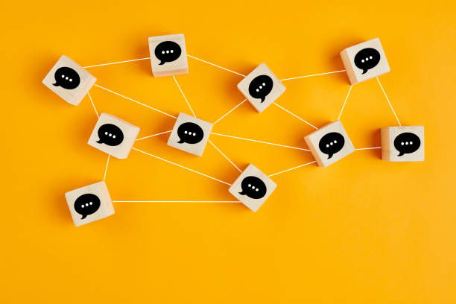
Some useful phrases to consider
“Help me understand how you feel when you….”
“Help me understand why you do X? How does it help you?”
Notes:
Trainer NB: Using phrases such as these can help a young person that we not only want to hear what they want to say, but also it can help us to understand what is going on for them. It is useful to think to yourself, what need might being met from a certain ritual or how might it feel to be this young person right now… thinking in such a way can help us to plan what provision will be needed for them.

Slide 61
What if you don’t feel comfortable with talking about a taboo topic?
You matter too…
We all have topics that we my feel uncomfortable with for a wide range of reasons.
These might be religious, cultural, due to past experiences of our own…
If we don’t feel comfortable discussing something, we might be able to find a colleague such as the school nurse or a more senior member of staff who can.
Notes:
Trainer NB: You could edit this slide to include named members of staff or teams… Following this slide, depending on your setting and also the level of experience your team has, you could consider some role play activities or case studies which could be discussed to think about how we handle certain conversations.
*The key message is, even if we don’t feel comfortable discussing something with a young person, we do need to at least pass on our concerns to someone who can speak with them*.

Slide 62
“Thank you for trusting me…”
We have considered how hard it is for a student to open up about a difficult topic.
We should acknowledge how hard this must have been and what a privilege it is for us that they have trusted us enough to have this discussion.
This might be more of a typical conversation for you, but this is their very first time possible when they have been able to brave and honest.
To show the conversation mattered to you you can thank them for trusting you.
Don't make promises you can't keep. Instead, remind them that you are going to support them through this time.

Slide 63
What will you do differently as a result of this training?

Slide 64
Referrals

Slide 65
Referrals Reflection
Does your organisation have a clear protocol for staff to understand when it is appropriate for them to provide support to CYP with low-level mental health needs, and when to make a referral?
What is the referral process? Is it clear?
Does your organisation have an emergency procedures in place for any CYP who experience a mental health crisis during the day, requiring external support?
Notes:
Individual reflection-5 mins

Slide 66
Referrals checklist
I know how to support colleagues in recording, monitoring, and providing appropriate support for CYP who are struggling with their mental health.
I have a good understanding of the local and national services in the local area
I have established effective working relationships with the key services in the local area

Slide 67
Referrals checklist
Ensure staff have received training on how to respond to a disclosure.
Ensure key staff are made aware of concerns about students .
Ensure that the referral system for students who are struggling with their mental health is clear and understood by all members of your school community
Ensure that there are resources available for students who need signposting to external services

Slide 68
Referrals checklist
Consider:
1. Who will be responsible for continuing to update the referral pathways and service provision map for your locality? How will this be monitored?
2. How can staff be supported to ensure that the right level of provision is implemented for the specific level of need for that young person?
Notes:
Discuss

Slide 69
What makes a good referral?
Before making a referral, have a clear outcome in mind. What do you want CYPMH (Child and Young People Mental Health Services), AMHS (Adult Mental Health Services) to do? You might be looking for advice, strategies, support or a diagnosis, for instance.
You must also be able to provide evidence to CYPMHS/AMHS about what intervention and support has been offered to the student by the organisation and the impact of this.

Slide 70
What to include …
How much a CYP’s difficulties are interfering with day-to-day life and progress.
How long a CYP has been struggling with symptoms/difficulties. Use a daily monitoring diary to describe how mental health needs and behaviours affect daily functioning and learning.
How many other difficulties and risks the CYP and family is facing.
How much a CYP’s safety may be compromised by their mental health difficulties.
Whether any other organisation based or community support has been tried.

Slide 71
Working with other agencies
Could you perhaps invite health and wellbeing professionals to an informal meet and greet as part of a team meeting or training session to share information about the service, work out the best ways to access their services, establish any referrals and protocol?
Allow time, both day-to-day and over a period of time, to really build meaningful relationships and put faces to names with external agencies including NHS CYPMHs (CYPMHS is used as a term for all services that work with children and young people who have difficulties with their emotional or behavioural wellbeing) and AMHS (Adult Mental Health Services).

Slide 72
Have you identified this area as an action point already?

Slide 73
Action ………..
Who will lead?
What further support or guidance will you require?
How will you share this with the wider college community?
How will you measure the impact of this action?
What are your next steps for this action? (SMART Goal)

Slide 74

Staff wellbeing
Discussion :
What steps can you take to look after your own mental health and wellbeing?
Any ideas for staff wellbeing initiatives within your setting?
Education Wellbeing Staff Charter: https://www.gov.uk/guidance/education-staff-wellbeing-charter
Notes:
Link to guide
Wellbeing action plan course
10 ways to support wellbeing: https://www.annafreud.org/schools-and-colleges/resources/ten-ways-to-support-school-staff-wellbeing/
Mental Health at Work: https://www.mentalhealthatwork.org.uk/toolkit/staff-mental-health-in-education/
Education Support: https://www.educationsupport.org.uk/get-help/help-for-your-staff/wellbeing-services/taking-care-of-teachers/

Slide 75


Slide 76
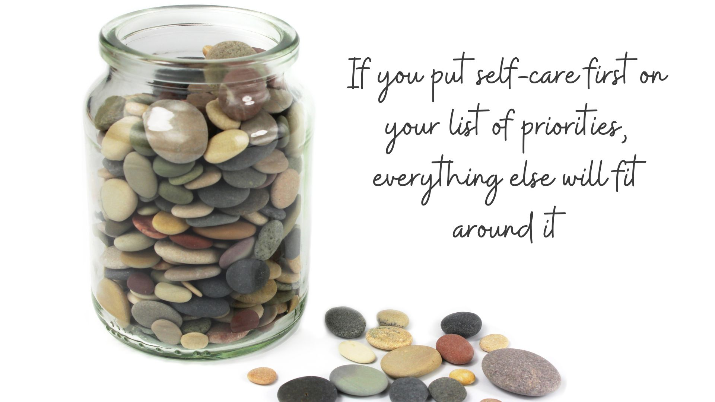

Slide 77
Train the Trainer: You Matter Too
Notes:
*It is likely that depending on the group of staff and setting this training is delivered to, you may be met with some resistance as those working in education really struggle with time. However, the key message is about small changes which can create larger ripples, enabling us to be more productive. This course has been devised to give you the time to consider what you can do for yourselves. We recognise how busy your roles are and how difficult it can be a difficult balance between work and your personal life. However, we would like to take this to run through some ideas and enable you to share some of your own strategies.

Slide 78
Group Agreement
Listen to those around us
Be non-judgmental
Share if we feel comfortable to do so
Be aware of your own mental health throughout
Take a break if you need to do so
Make a safe learning environment to make people feel able to be as honest as they would like to be.
Notes:
In this session, we will be talking about our own mental health and wellbeing. Are there any other agreements you would like to add so that we can create a safe space to share what we wish to during this time?

Slide 79
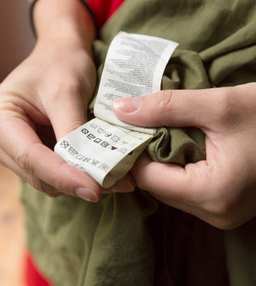
Ever had an irritating clothing label?
You are running late for work and notice an annoying clothing label.
You leave it and run out of the door.
You catch yourself scratching at it throughout the day.
You intended on removing it at lunchtime but got caught up with something else.
Notes:
Discuss the scenario with the group. Use the question on the next slide to generate discussion.

Slide 80
How does it feel by the end of the day?
Notes:
Groups might suggest that they have been itching at it… feeling annoyed by the end of the day as it has been frustrating…. Perhaps for others, the thoughts, feelings, behaviours will be different. All are valid.

Slide 81
What does this have to do with mental wellbeing?
Working in education can be both tough and rewarding.
At times it can feel physically and emotionally difficult perhaps due to Safeguarding and Mental Health issues of young people the workload and more.
The clothing label analogy reminds us of the need to take time each day to give ourselves the opportunity for self-care and to refill our batteries.
Notes:
Working in education can be both tough and rewarding. At times it can feel physically and emotionally difficult perhaps due to Safeguarding and mental health issues of young people, the workload and more so the clothing label analogy reminds us of the need to take time each day to give ourselves the opportunity for self-care and to refill our batteries.

Slide 82
Why is staff mental wellbeing more important than ever before?
The pandemic has had an impact on everyone to some extent.
Even though these experiences and the way we process them will be unique to each of us, it is important that we think of ourselves too so that we can continue to support children and young people.
Remember care and compassion for each other and ourselves.
Notes:
The pandemic has had an impact on everyone to some extent, adults, children and young people alike. We all have had different experiences, thoughts and feelings but as individuals working within the education profession, we are supporting others who have experienced a range of traumatic experiences e.g. sudden losses in the family, financial difficulties and more. Therefore, we must remember self-compassion Many children and young people have been excited and looking forward to the return to school. For many children, the return to school and reconnection with familiar relationships and routines will be key factors, facilitating their resilience.

Slide 83
What signs might show us a colleague is struggling?
We need to take care not to generalise as each person will present differently but:
Being more or less social than usual
Isolating themselves from others
Be Tearful
Struggling to cope with change
Find decision making challenging
Low energy or concentration levels

Slide 84
Checklist for talking to a colleague about their mental wellbeing
Safe Space
Let them share what they want to and don’t lead them with your questions
Listen without judgement
Think back to a time when you really felt heard, what did the person do to validate your feelings? What help you feel heard?
Add this to your checklist…
Notes:
Safe space: Before starting a conversation with someone about their mental health, make sure you’re in a safe and confidential space. No pupils or colleagues should be able to overhear you. You should be free from distractions and be able to commit the time needed for the conversation. The time should also be right for the person you’re checking in on.
It’s important we stick to open questions rather guiding the conversation in a certain direction e.g would you like to tell me a bit about X? I have noticed you don’t seem yourself recently, I am happy to listen if it helps to talk?
Talking about mental health can be difficult so we need to use active listening strategies and give our full attention to the person sharing…

Slide 85
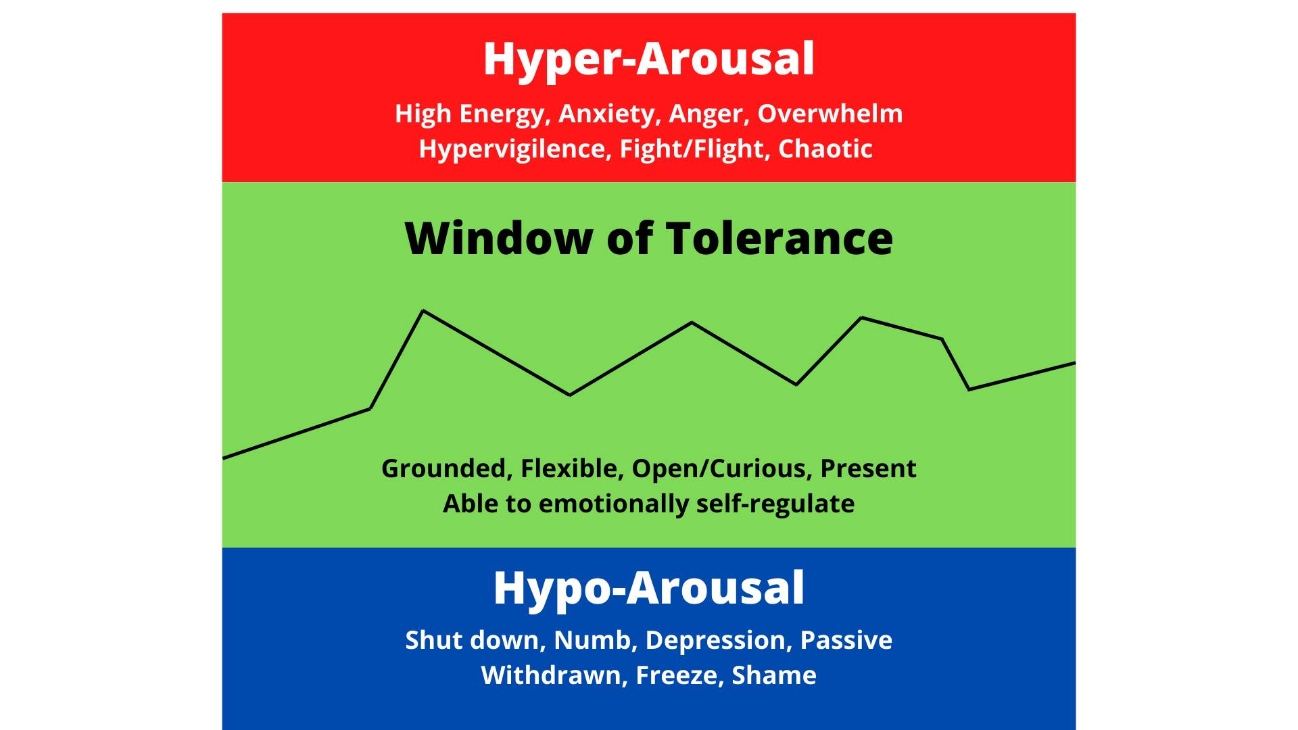
Our Window of Tolerance
Notes:
Prompt:
Dr Dan Siegel originally created this model to be used in the therapy room but it can really help us to understand when we are in our window of tolerance e.g. coping well.
When we are aware of our own signs of distress or when we are not coping, we can understand when to implement our own self-care.
Hypo-arousal… These are times when we might feel low, disinterested, have trouble focusing or lack motivation. The top signifies hyper-arousal. Times when we find it hard to calm ourselves. We may find our heart pounding, we might be breathless or struggling to regulate ourselves due to feelings of anxiety.

Slide 86
Ensuring our own wellbeing...
Research indicates that taking the following steps can be important in the promotion and maintenance of mental wellbeing:
Knowing your personal limits and having the ability to say ‘No’ when necessary.
Identifying supportive people that you have in your life. Do you want to and / or need to increase support networks?
Talking – there are times when challenging situations affect us emotionally. Talk to someone before leaving school / college. Separate work and homelife.
Being flexible around change.
Self-compassion. Take time to stop and reflect on thoughts in your head, are they more positive or critical?

Slide 87
What might you notice within yourself that might alert you to needing to share with someone else?

Slide 88
Signs within ourself that we are moving out of our window of tolerance
Some examples are:
Sleeping more or less
Eating more or less
Wanting to distance ourselves or spend more time with others
Not able to switch off at the end of the day
Differences in your inner thoughts e.g. feeling ashamed, underwhelmed etc...

Slide 89
What can you do to help yourself stay in the zone of tolerance?

Slide 90
Do you have a coping toolbox?
Create mindful moments e.g body scans, paying full attention to the flavours and textures of your lunch… (Or anything else you can do to create so moments just for yourself).
Take short mindful walks pay attention to the sounds outside, the breeze on your face, the feel of the ground beneath you.
Socially connect with colleagues: pop into someone’s room to spark some joy for them, have a chat over coffee with a colleague. Make time.
What else could go in your coping toolbox?
Notes:
We dont have much time or space during the working day but snatching 10 minutes in your room, car, or in a quiet corner of school can make all the difference. You could try short meditations such as a body scan.
Body scan instructions:
1. Find somewhere quiet and comfortable.
2. Focus on your breath for a few moments. Inhaling through the nose and exhaling through the mouth. Imagine that your abdomen is balloon that needs filling and shrinking… ‘belly breaths’ often bring about a greater sense of relaxation.
Bring your attention to your feet. Notice any pain. Gentle wiggle your toes and stretch your feet, breathing through those moment.
3. Visualise that pain and tension drifting out of your body…
4. Gradual move up through your legs, abdomen, chest, arms, shoulders, neck and head… noticing any tension and breathing through it… seeing it leave your body.

Slide 91
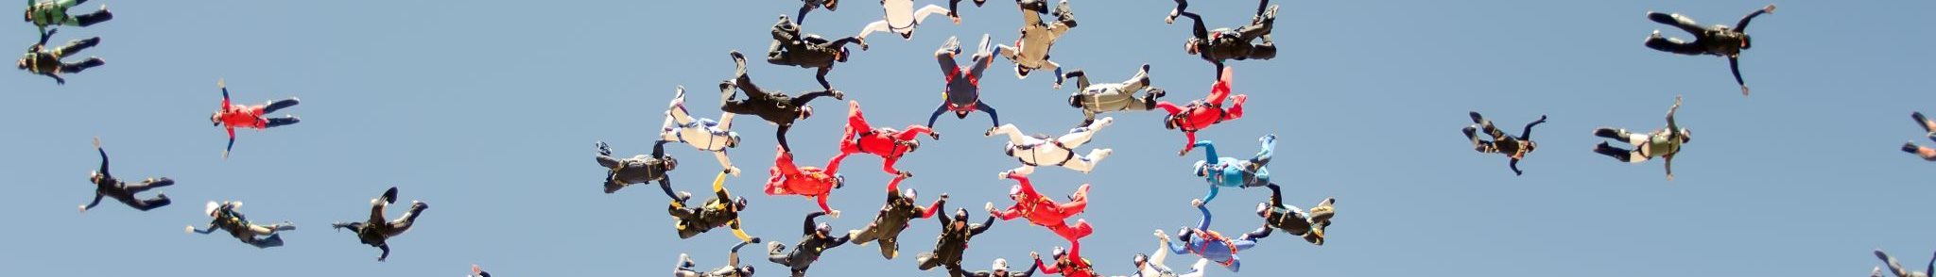
Does having more rest or more family time make you more effective?

Slide 92
Role Modelling
Charging our batteries, being a wellbeing role model for young people and getting enough sleep has been found to significantly enhance performance and our ability to organise ourselves in more effective ways so that work doesn’t consume our whole week.
However, there is lots more to this than looking after our health.
Notes:
DISCUSSION?

Slide 93

To don’t list
Are there work-based activities that you do that don’t really need to be done?
We need to be honest about what we don’t need to do.
Could a to don’t list work for you?
Notes:
Some ideas that might go onto this list each day might be not signing up the kids for x,y,z activity at an unrealistic when you cant get them there easily, don’t empty your email inbox on that same day-deal with urgent things first, don’t say yes to every social engagement don’t work at night (unless that is actually your job of course). Be clear with others that you will respond to emails within 24-48 hours... this manages their expectations but also gives you some breathing room to make time for what really matters in that moment.

Slide 94
Recognising our limits
Knowing personal limits and having the ability to say ‘no’ when necessary is important.
This helps you to have more balance in life and will enable you to take better care of others.
Self-compassion. If you take some time to stop and reflect on the thoughts in your head, are they more positive or critical? Once you have identified any negative thought, you can begin to introduce more positive thoughts and ‘turn the volume down’ on the critical voices.

Slide 95
If you had a new member of the team working with you, what would you hope for them? How would their work-life balance look?
How does this compare to your current working week?
Notes:
You can control this. How can you role model and make some small changes to establish a balance.
For those in leadership positions or perhaps aspiring to be, what might a mindful communications plan look like?

Slide 96

Develop your own ways of shutting off at the end of the day…
Let’s share together what we do to wind down.
How do you manage to grab those precious moments of self-care?
To use the words of Tim Brighouse, what are your self-care “butterflies”? Things that are simple to do but have a high impact…

Slide 97
Where can you reach out for more support?

Slide 98
What can we do to reach out for more support?
In school support
Employee Assistance Programme
Education Support Partnership
Personal coaching/counselling (sometimes we are really not ok and need to invest in ourselves)
Speak to your GP
The earlier we ask for help, the more options we have…

Slide 99
Useful sources of support
https://www.annafreud.org/schools-and-colleges/resources/supporting-staff-wellbeing-in-schools/
https://www.mentallyhealthyschools.org.uk/whole-school-approach/supporting-staff-wellbeing/
https://www.nhs.uk/conditions/stress-anxiety-depression/improve-mental-wellbeing/
https://www.annafreud.org/media/7653/3rdanna-freud-booklet-staff-wellbeing-web-pdf-21-june.pdf
https://assets.markallengroup.com//article-images/228645/B2S2-July2020-StaffWellbeing.pdf
http://mentalhealthatwork.org.uk
http://mindfulteachers.org
https://www.educationsupport.org.uk/helping-you/telephone-support-counselling

Slide 100
Small Intervention Project
Using the areas identified on your settings audit as requiring improvement, select one area as your focus to conduct a small intervention that you can measure the effectiveness of. By the end of the programme, you will create and deliver a 5-7 minute presentation.
The Presentation
The presentation is an informal way of being able to share your project and what was learnt
You may wish to use the following headings to help to shape your presentation:
Rationale for the project
What was implemented?
How was success measured?
What was learnt in the process?
Future plans

Slide 101
Small Intervention Project
At your tables, share your ideas and progress to date:
Rationale for the project
What was implemented?
How was success measured?
What was learnt in the process?
Future plans

Slide 102
Department for Education Survey
Please look out for an email from Creative Education with this survey link.
Feedback Surveys
This survey is important as we have to report back to the DfE.
Notes:
Coach NB: Please ensure that the survey is completed in the session and sent out to those who are not in attendance as it is a mandatory component which will determine whether they get their certificate or not.

Slide 103

What’s next?
Submission of work to your trainer by 31st July 2025: Audit, Action Plan, Mapping Document, SIP
Course Certification
Creative Education Mental Health Network

Slide 104

The Team Around You
"Alone we can do so little; together we can do so much."
Helen Keller

Slide 105
The Team Around You
We must hold in mind that the knowledge, skills and expertise you possess can only shine through when we enable others to be part of the transformation journey.
Consider whether a Mental Health Action Group which comprises of young people, your team, and members of the wider community could be set up.
Mental Health Action Groups can be useful to continue change and review progress.

